Slide 1

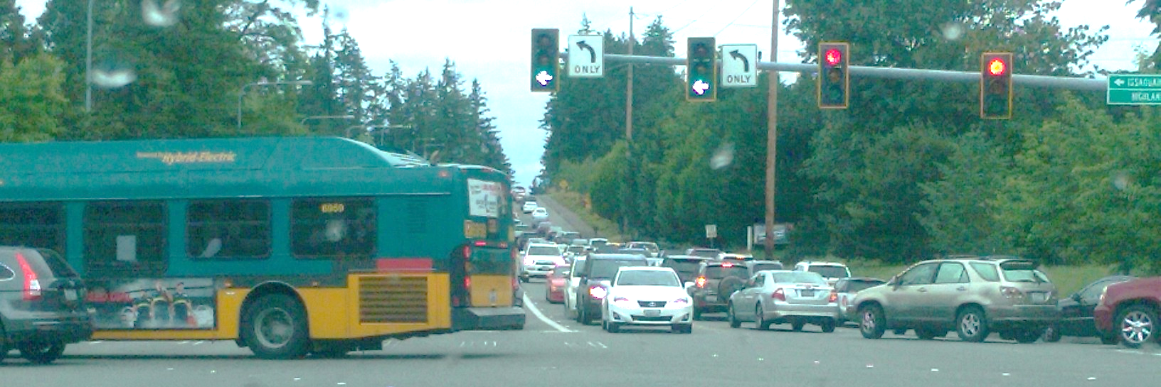

City of Sammamish
Issaquah-Fall City Road Improvements Project
Phase I Design: 242nd Avenue SE to Klahanie Drive SE
City Council Update
Tuesday, January 10, 2017
Sammamish City Hall
Notes:
KRISTINE
Welcome and introduce self and facilitator role
I first wanted to recognize any Council Members who have joined us this evening. If I can ask you to stand and wave, that would be great!
Also have quick introductions from the project team
From the City:
Sam Park, Project Manager
Steve Leniszewski, Director of Public Works
Cheryl Paston, Deputy Director of Public Works
Jim Grueber, Senior Project Engineer
Andrew Zagars, City Engineer
From HW Lochner, Consulting Engineer
Steve Lewis
Mark Burrus
Molly Toy
Rich Meredith
From EnviroIssues
(Kerri Franklin)
Kelly Foley – taking notes!

Slide 2
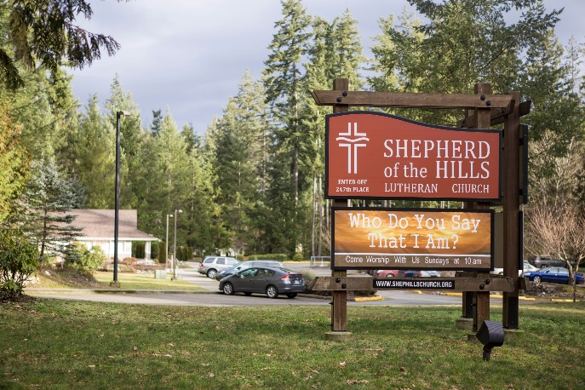
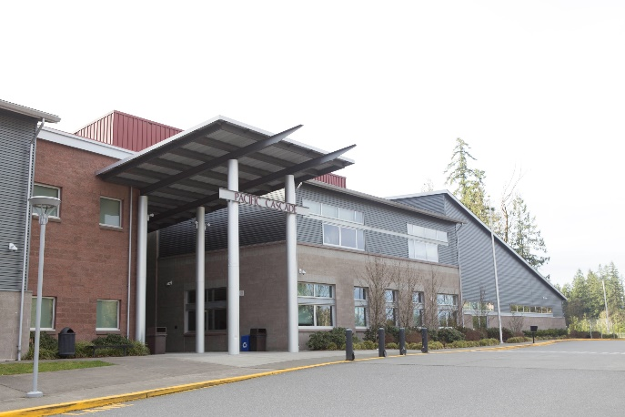
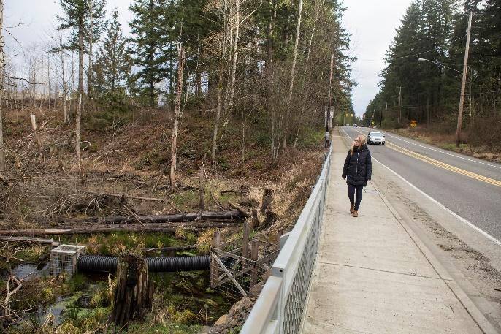
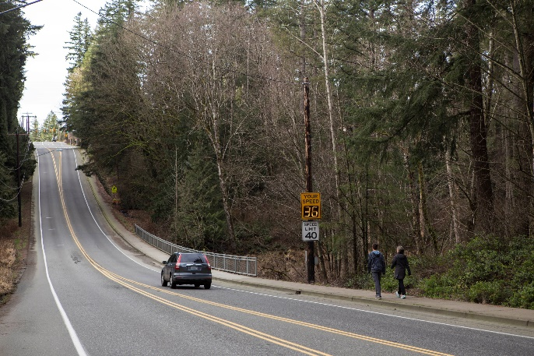
Meeting Agenda
2
Introductions
Project Overview
Where Have We Been
Where Are We Now
Focus for Tonight
Direction from Council
Notes:
KRISTINE
Welcome and introduce self and facilitator role
I first wanted to recognize any Council Members who have joined us this evening. If I can ask you to stand and wave, that would be great!
Also have quick introductions from the project team
From the City:
Sam Park, Project Manager
Steve Leniszewski, Director of Public Works
Cheryl Paston, Deputy Director of Public Works
Jim Grueber, Senior Project Engineer
Andrew Zagars, City Engineer
From HW Lochner, Consulting Engineer
Steve Lewis
Mark Burrus
Molly Toy
Rich Meredith
From EnviroIssues
(Kerri Franklin)
Kelly Foley – taking notes!

Slide 3
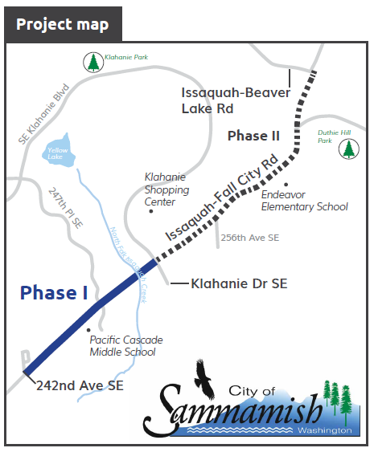
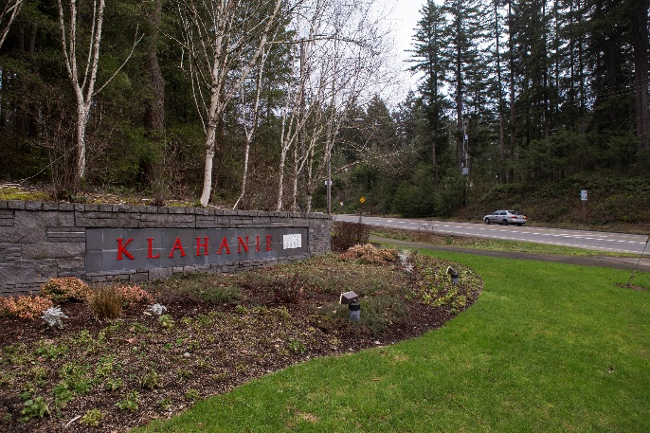
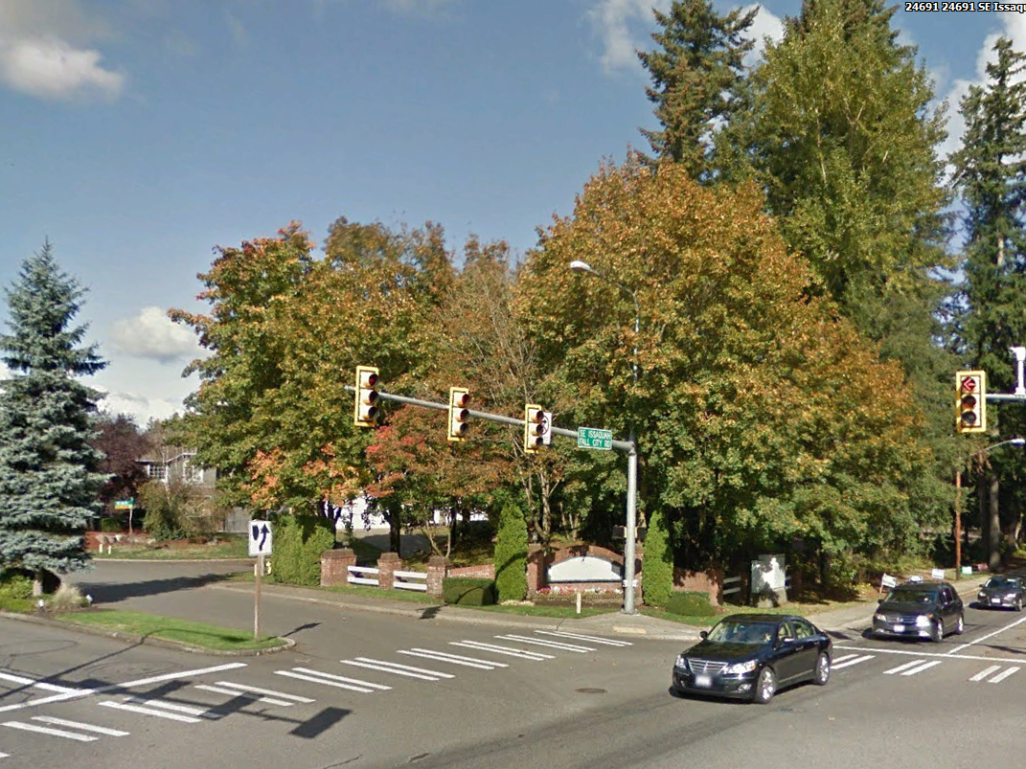
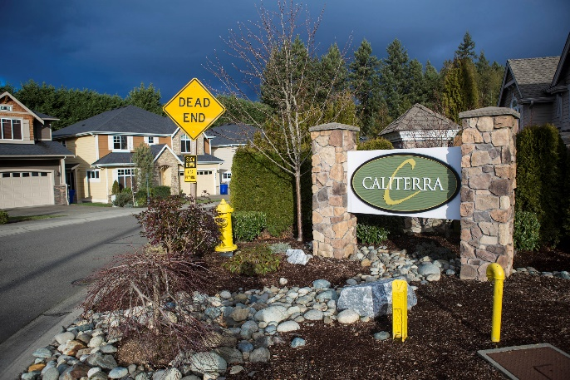
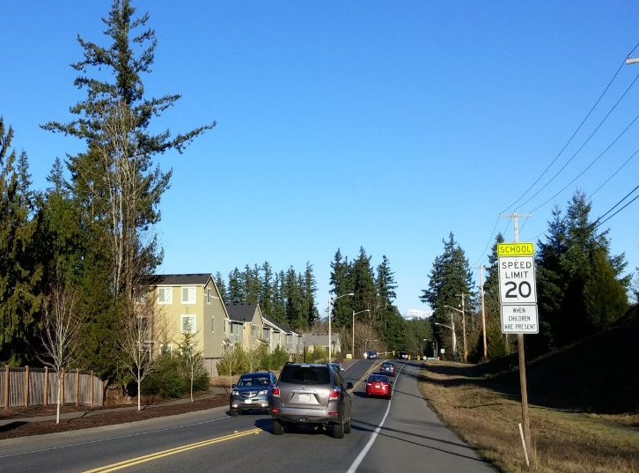
Project Overview
3
Notes:
KRISTINE
Welcome and introduce self and facilitator role
I first wanted to recognize any Council Members who have joined us this evening. If I can ask you to stand and wave, that would be great!
Also have quick introductions from the project team
From the City:
Sam Park, Project Manager
Steve Leniszewski, Director of Public Works
Cheryl Paston, Deputy Director of Public Works
Jim Grueber, Senior Project Engineer
Andrew Zagars, City Engineer
From HW Lochner, Consulting Engineer
Steve Lewis
Mark Burrus
Molly Toy
Rich Meredith
From EnviroIssues
(Kerri Franklin)
Kelly Foley – taking notes!

Slide 4
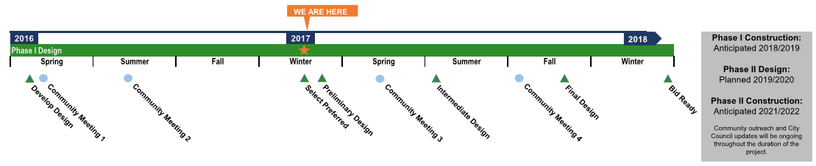
Project Timeline
4
Notes:
KRISTINE
Welcome and introduce self and facilitator role
I first wanted to recognize any Council Members who have joined us this evening. If I can ask you to stand and wave, that would be great!
Also have quick introductions from the project team
From the City:
Sam Park, Project Manager
Steve Leniszewski, Director of Public Works
Cheryl Paston, Deputy Director of Public Works
Jim Grueber, Senior Project Engineer
Andrew Zagars, City Engineer
From HW Lochner, Consulting Engineer
Steve Lewis
Mark Burrus
Molly Toy
Rich Meredith
From EnviroIssues
(Kerri Franklin)
Kelly Foley – taking notes!

Slide 5
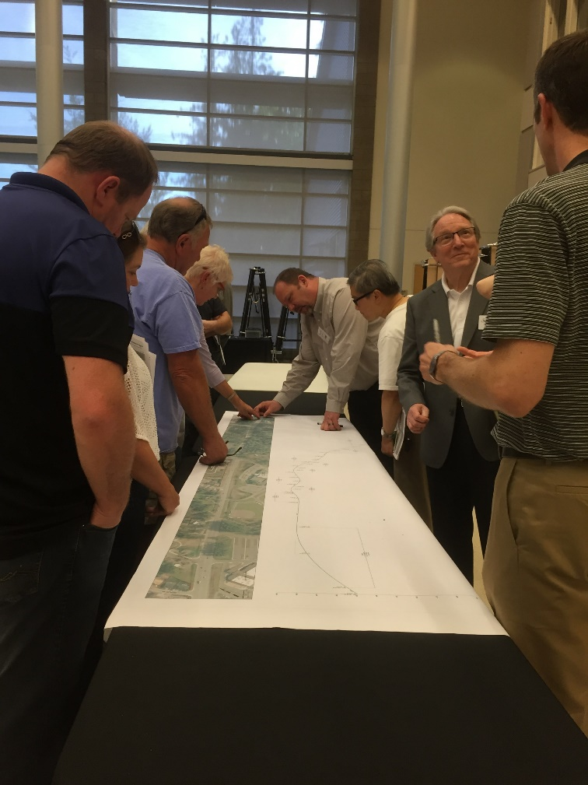
Where Have We Been
5
Three City Council Meetings
Several Transportation Committee Meetings
Two Public Open House Presentations
Two Meetings with Pacific Cascade Middle School
Four Meetings with Eastridge Church & Their Engineer
One Meeting with Shepherd of the Hills
Presentation to HOA Representatives
Several Individual Meetings with Key Stakeholders
Notes:
KRISTINE
Welcome and introduce self and facilitator role
I first wanted to recognize any Council Members who have joined us this evening. If I can ask you to stand and wave, that would be great!
Also have quick introductions from the project team
From the City:
Sam Park, Project Manager
Steve Leniszewski, Director of Public Works
Cheryl Paston, Deputy Director of Public Works
Jim Grueber, Senior Project Engineer
Andrew Zagars, City Engineer
From HW Lochner, Consulting Engineer
Steve Lewis
Mark Burrus
Molly Toy
Rich Meredith
From EnviroIssues
(Kerri Franklin)
Kelly Foley – taking notes!

Slide 6
Design Elements
6
Buffered Bike Lanes
Amenity Zone
Enhanced Landscaping
Lighting
Sidewalks
Notes:
KRISTINE
Welcome and introduce self and facilitator role
I first wanted to recognize any Council Members who have joined us this evening. If I can ask you to stand and wave, that would be great!
Also have quick introductions from the project team
From the City:
Sam Park, Project Manager
Steve Leniszewski, Director of Public Works
Cheryl Paston, Deputy Director of Public Works
Jim Grueber, Senior Project Engineer
Andrew Zagars, City Engineer
From HW Lochner, Consulting Engineer
Steve Lewis
Mark Burrus
Molly Toy
Rich Meredith
From EnviroIssues
(Kerri Franklin)
Kelly Foley – taking notes!

Slide 7
Full Design Layout
7

Slide 8
Community Concerns
8
Roundabout at 242nd Avenue SE (Eastridge Church)
Pedestrian Safety
  Pedestrian crossings at 247th Place SE (Pacific Cascade Middle School)
Protecting Green Space and Trails
Noise Level
  Mainly phase II of the project
Notes:
KRISTINE
Welcome and introduce self and facilitator role
I first wanted to recognize any Council Members who have joined us this evening. If I can ask you to stand and wave, that would be great!
Also have quick introductions from the project team
From the City:
Sam Park, Project Manager
Steve Leniszewski, Director of Public Works
Cheryl Paston, Deputy Director of Public Works
Jim Grueber, Senior Project Engineer
Andrew Zagars, City Engineer
From HW Lochner, Consulting Engineer
Steve Lewis
Mark Burrus
Molly Toy
Rich Meredith
From EnviroIssues
(Kerri Franklin)
Kelly Foley – taking notes!

Slide 9
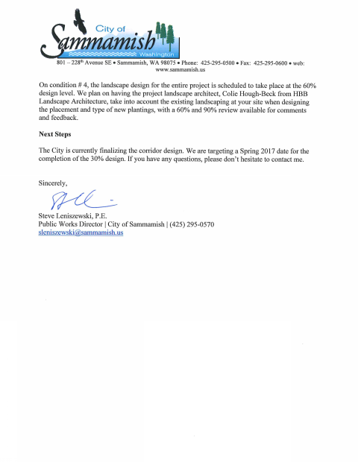
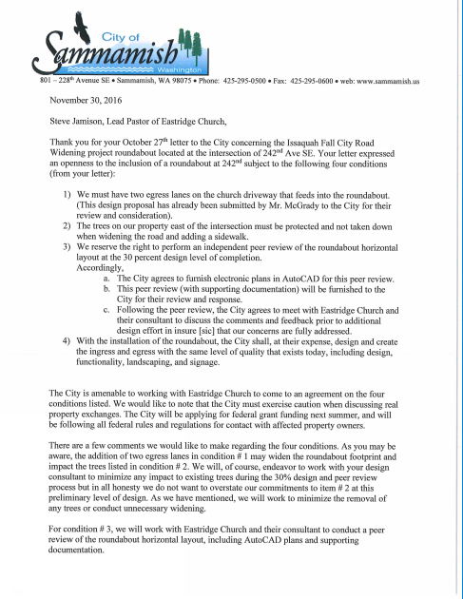
Resolution of Roundabout at 242nd Avenue SE
9
Eastridge Church and City Agree to Plan Roundabout Together - November 30, 2016
Reduces Center Median Width
Reduces Overall Project Cost by $1.8M
Less Storm Water Runoff & Treatment
Less Right-of-Way Impacts on Homeowners
Less Environmental Impact – Trees
Less Wall Needed due to Side Slopes
Eliminates Use of Calterra and Hunter’s Place Subdivisions for U-Turns
Roundabouts Become U-Turn Option
Notes:
KRISTINE
Welcome and introduce self and facilitator role
I first wanted to recognize any Council Members who have joined us this evening. If I can ask you to stand and wave, that would be great!
Also have quick introductions from the project team
From the City:
Sam Park, Project Manager
Steve Leniszewski, Director of Public Works
Cheryl Paston, Deputy Director of Public Works
Jim Grueber, Senior Project Engineer
Andrew Zagars, City Engineer
From HW Lochner, Consulting Engineer
Steve Lewis
Mark Burrus
Molly Toy
Rich Meredith
From EnviroIssues
(Kerri Franklin)
Kelly Foley – taking notes!

Slide 10
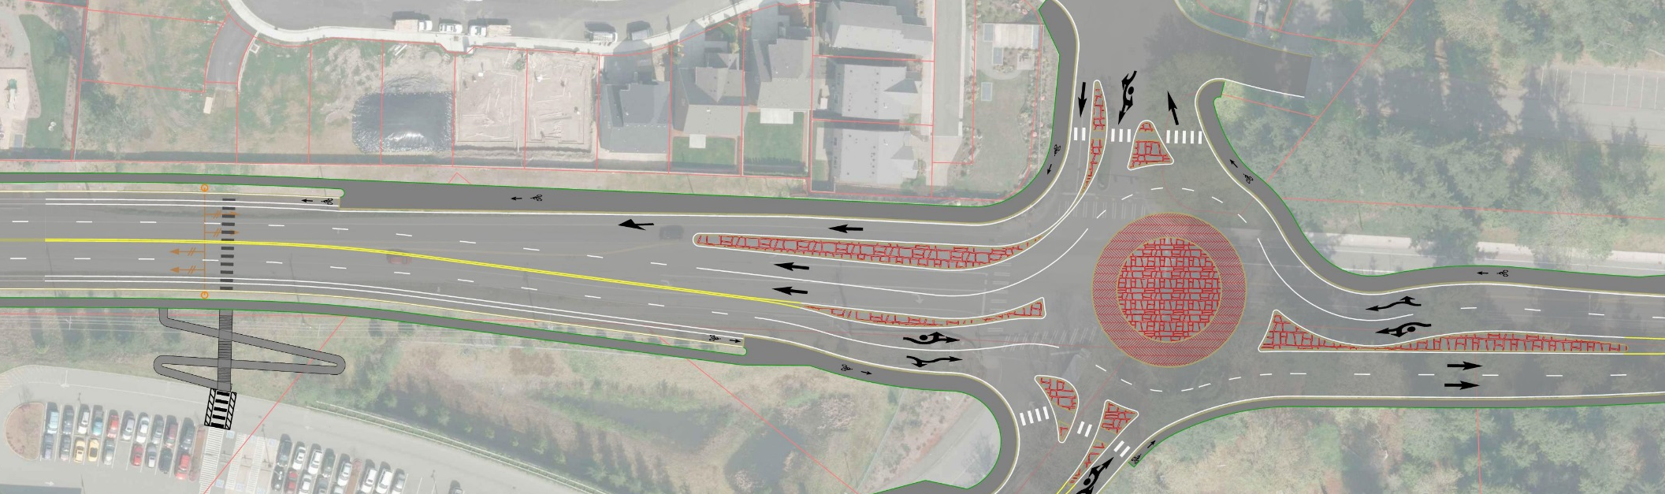
Resolution for Pedestrian Crossing
10
Shift Roundabout South and East and Eliminate Impact to Home of NW Corner
Shift Crosswalk Away from Intersection to Align with School Entrance
Install HAWK (High-intensity Activated crossWalK) Beacon
N
Notes:
KRISTINE
Welcome and introduce self and facilitator role
I first wanted to recognize any Council Members who have joined us this evening. If I can ask you to stand and wave, that would be great!
Also have quick introductions from the project team
From the City:
Sam Park, Project Manager
Steve Leniszewski, Director of Public Works
Cheryl Paston, Deputy Director of Public Works
Jim Grueber, Senior Project Engineer
Andrew Zagars, City Engineer
From HW Lochner, Consulting Engineer
Steve Lewis
Mark Burrus
Molly Toy
Rich Meredith
From EnviroIssues
(Kerri Franklin)
Kelly Foley – taking notes!

Slide 11
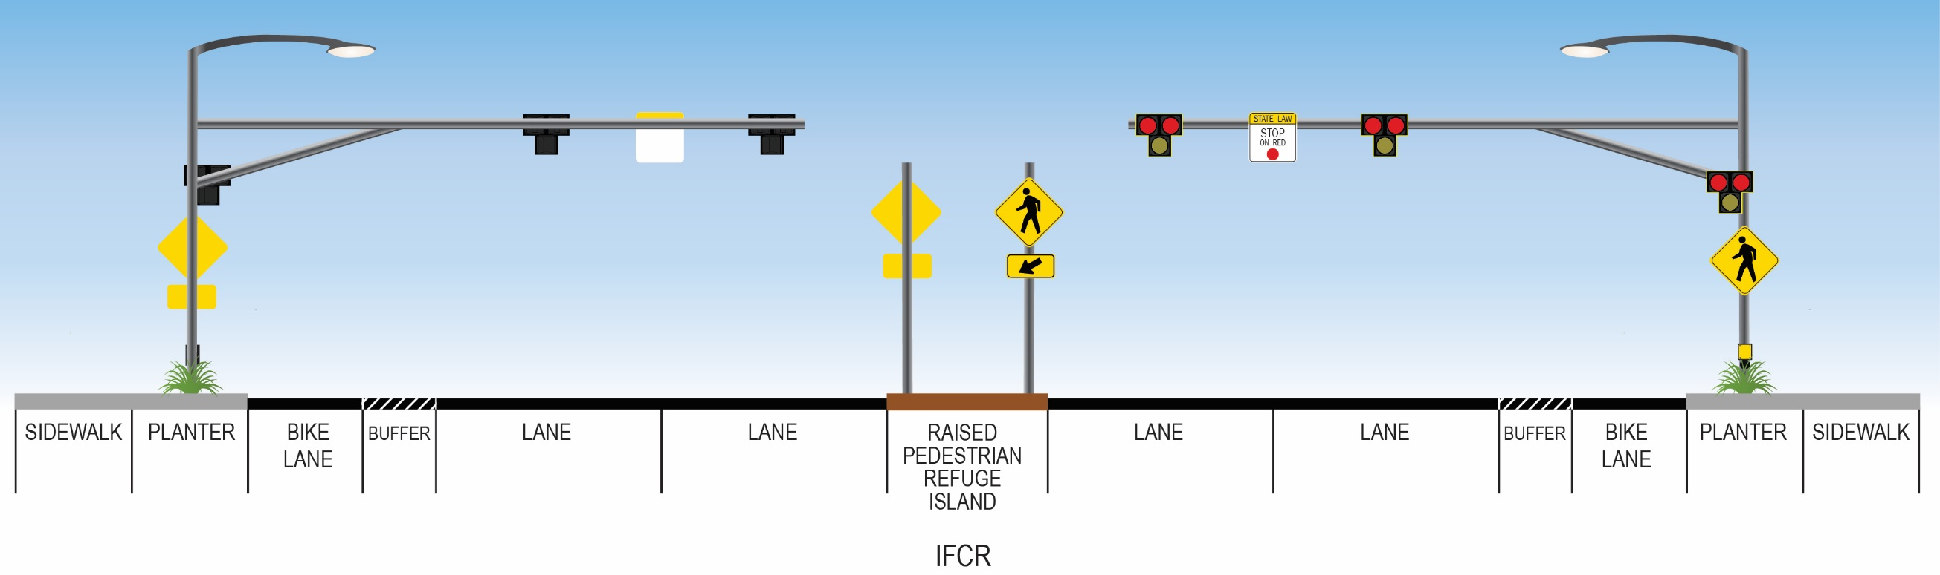
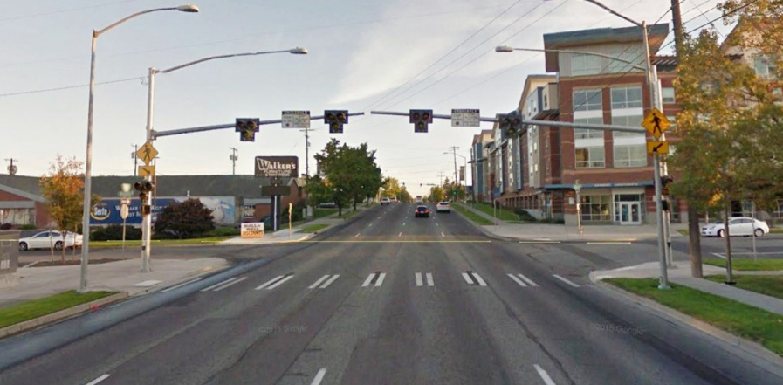
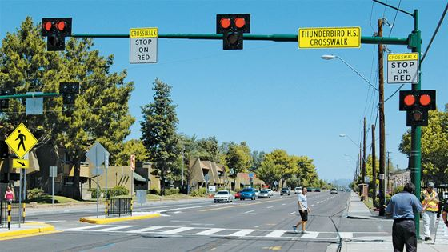
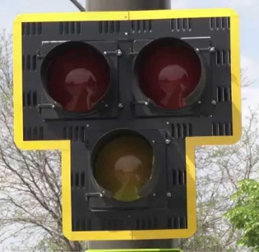
HAWK Beacon for Pacific Cascade Middle School
11
Notes:
KRISTINE
Welcome and introduce self and facilitator role
I first wanted to recognize any Council Members who have joined us this evening. If I can ask you to stand and wave, that would be great!
Also have quick introductions from the project team
From the City:
Sam Park, Project Manager
Steve Leniszewski, Director of Public Works
Cheryl Paston, Deputy Director of Public Works
Jim Grueber, Senior Project Engineer
Andrew Zagars, City Engineer
From HW Lochner, Consulting Engineer
Steve Lewis
Mark Burrus
Molly Toy
Rich Meredith
From EnviroIssues
(Kerri Franklin)
Kelly Foley – taking notes!

Slide 12

Issues Impacting Design Decisions
12
Existing Conditions
  SAG curve
  Critical areas
  Existing culvert
Time for Construction
Staging Options
Truck Traffic
Emergency Services
Cost
Notes:
KRISTINE
Welcome and introduce self and facilitator role
I first wanted to recognize any Council Members who have joined us this evening. If I can ask you to stand and wave, that would be great!
Also have quick introductions from the project team
From the City:
Sam Park, Project Manager
Steve Leniszewski, Director of Public Works
Cheryl Paston, Deputy Director of Public Works
Jim Grueber, Senior Project Engineer
Andrew Zagars, City Engineer
From HW Lochner, Consulting Engineer
Steve Lewis
Mark Burrus
Molly Toy
Rich Meredith
From EnviroIssues
(Kerri Franklin)
Kelly Foley – taking notes!

Slide 13
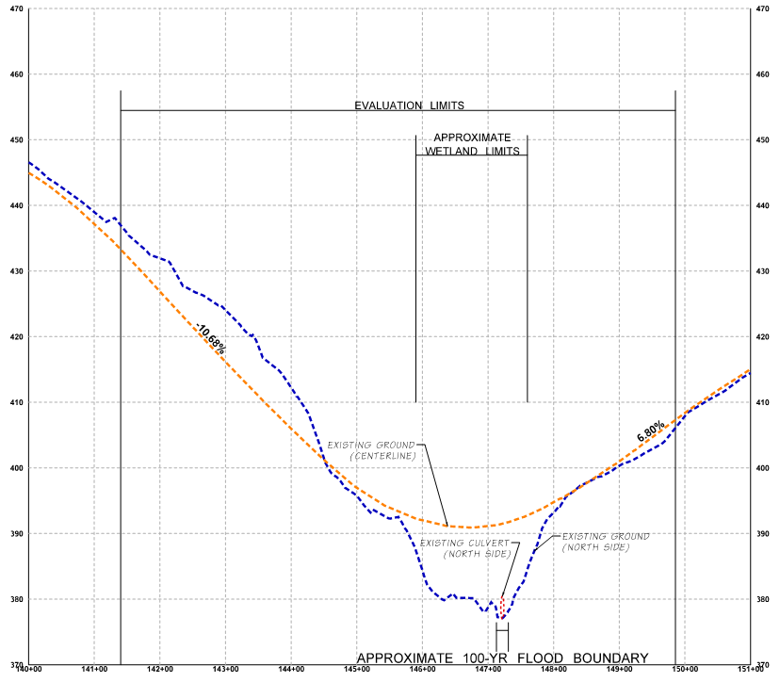
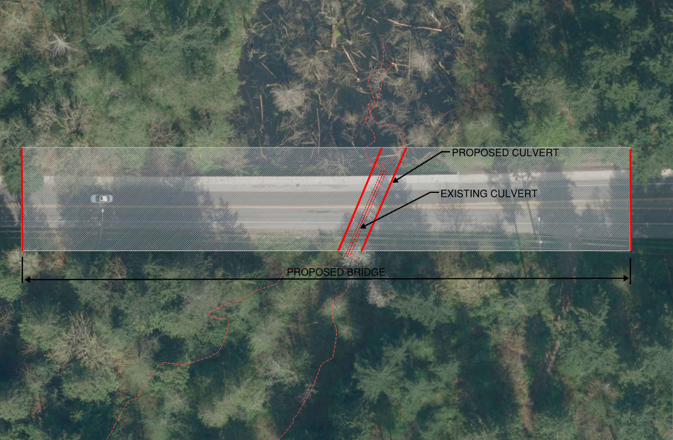
Where Are We Now
13
Resolving North Issaquah Creek Crossing
Cost & Community Impacts
Culvert vs Bridge
N
Notes:
KRISTINE
Welcome and introduce self and facilitator role
I first wanted to recognize any Council Members who have joined us this evening. If I can ask you to stand and wave, that would be great!
Also have quick introductions from the project team
From the City:
Sam Park, Project Manager
Steve Leniszewski, Director of Public Works
Cheryl Paston, Deputy Director of Public Works
Jim Grueber, Senior Project Engineer
Andrew Zagars, City Engineer
From HW Lochner, Consulting Engineer
Steve Lewis
Mark Burrus
Molly Toy
Rich Meredith
From EnviroIssues
(Kerri Franklin)
Kelly Foley – taking notes!

Slide 14
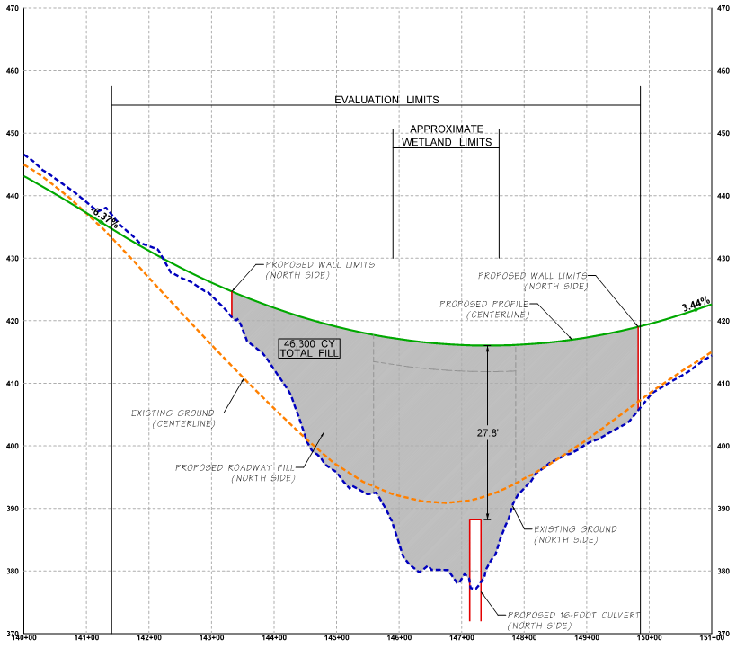

North Iss. Creek – Proposed Conditions (Culvert)
14
Proposed Slope = ~6%
Fill = 46,300 CY
Truck Loads = 90,800 TONS → >6000 Trucks
= 500, 15 TON loads
Estimated Construction Material Cost = $3.67M
Notes:
KRISTINE
Welcome and introduce self and facilitator role
I first wanted to recognize any Council Members who have joined us this evening. If I can ask you to stand and wave, that would be great!
Also have quick introductions from the project team
From the City:
Sam Park, Project Manager
Steve Leniszewski, Director of Public Works
Cheryl Paston, Deputy Director of Public Works
Jim Grueber, Senior Project Engineer
Andrew Zagars, City Engineer
From HW Lochner, Consulting Engineer
Steve Lewis
Mark Burrus
Molly Toy
Rich Meredith
From EnviroIssues
(Kerri Franklin)
Kelly Foley – taking notes!

Slide 15
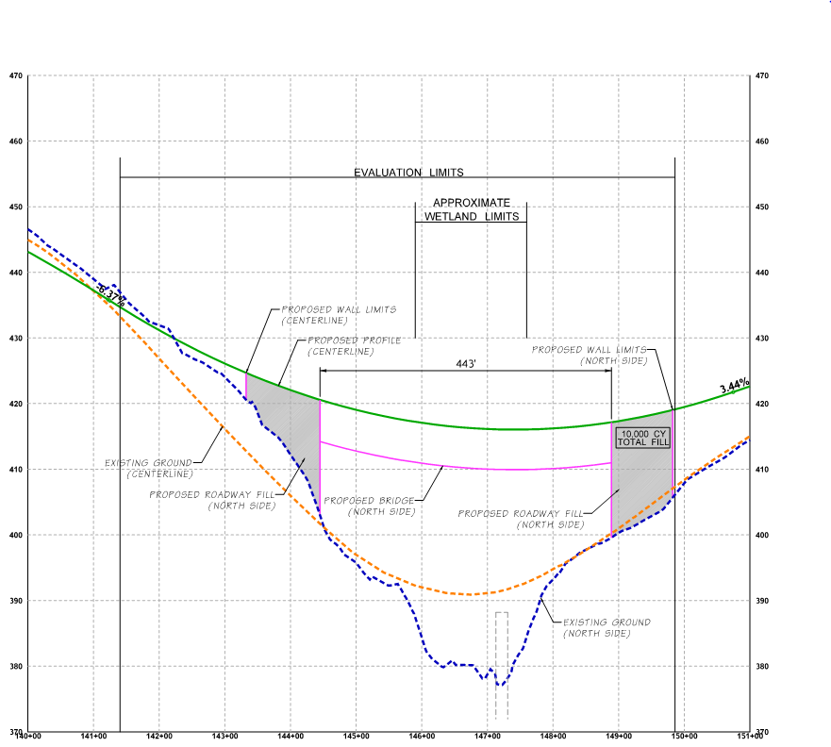
North Iss. Creek – Proposed Conditions (Bridge)
15
Proposed Slope = ~6%
Fill = 10,000 CY
Truck Loads = 15,000 TONS → >1000 Trucks
= 500, 15 TON loads
Estimated Construction Material Cost = $6.20M
Notes:
KRISTINE
Welcome and introduce self and facilitator role
I first wanted to recognize any Council Members who have joined us this evening. If I can ask you to stand and wave, that would be great!
Also have quick introductions from the project team
From the City:
Sam Park, Project Manager
Steve Leniszewski, Director of Public Works
Cheryl Paston, Deputy Director of Public Works
Jim Grueber, Senior Project Engineer
Andrew Zagars, City Engineer
From HW Lochner, Consulting Engineer
Steve Lewis
Mark Burrus
Molly Toy
Rich Meredith
From EnviroIssues
(Kerri Franklin)
Kelly Foley – taking notes!

Slide 16
Time of Construction
16
Culvert |  | Bridge
Full Closure | Staged Construction | Full Closure | Staged Construction
60 to 80 days | 100 to 140 days | 100 to 160 days | 200 to 300 days
Notes:
KRISTINE
Welcome and introduce self and facilitator role
I first wanted to recognize any Council Members who have joined us this evening. If I can ask you to stand and wave, that would be great!
Also have quick introductions from the project team
From the City:
Sam Park, Project Manager
Steve Leniszewski, Director of Public Works
Cheryl Paston, Deputy Director of Public Works
Jim Grueber, Senior Project Engineer
Andrew Zagars, City Engineer
From HW Lochner, Consulting Engineer
Steve Lewis
Mark Burrus
Molly Toy
Rich Meredith
From EnviroIssues
(Kerri Franklin)
Kelly Foley – taking notes!

Slide 17
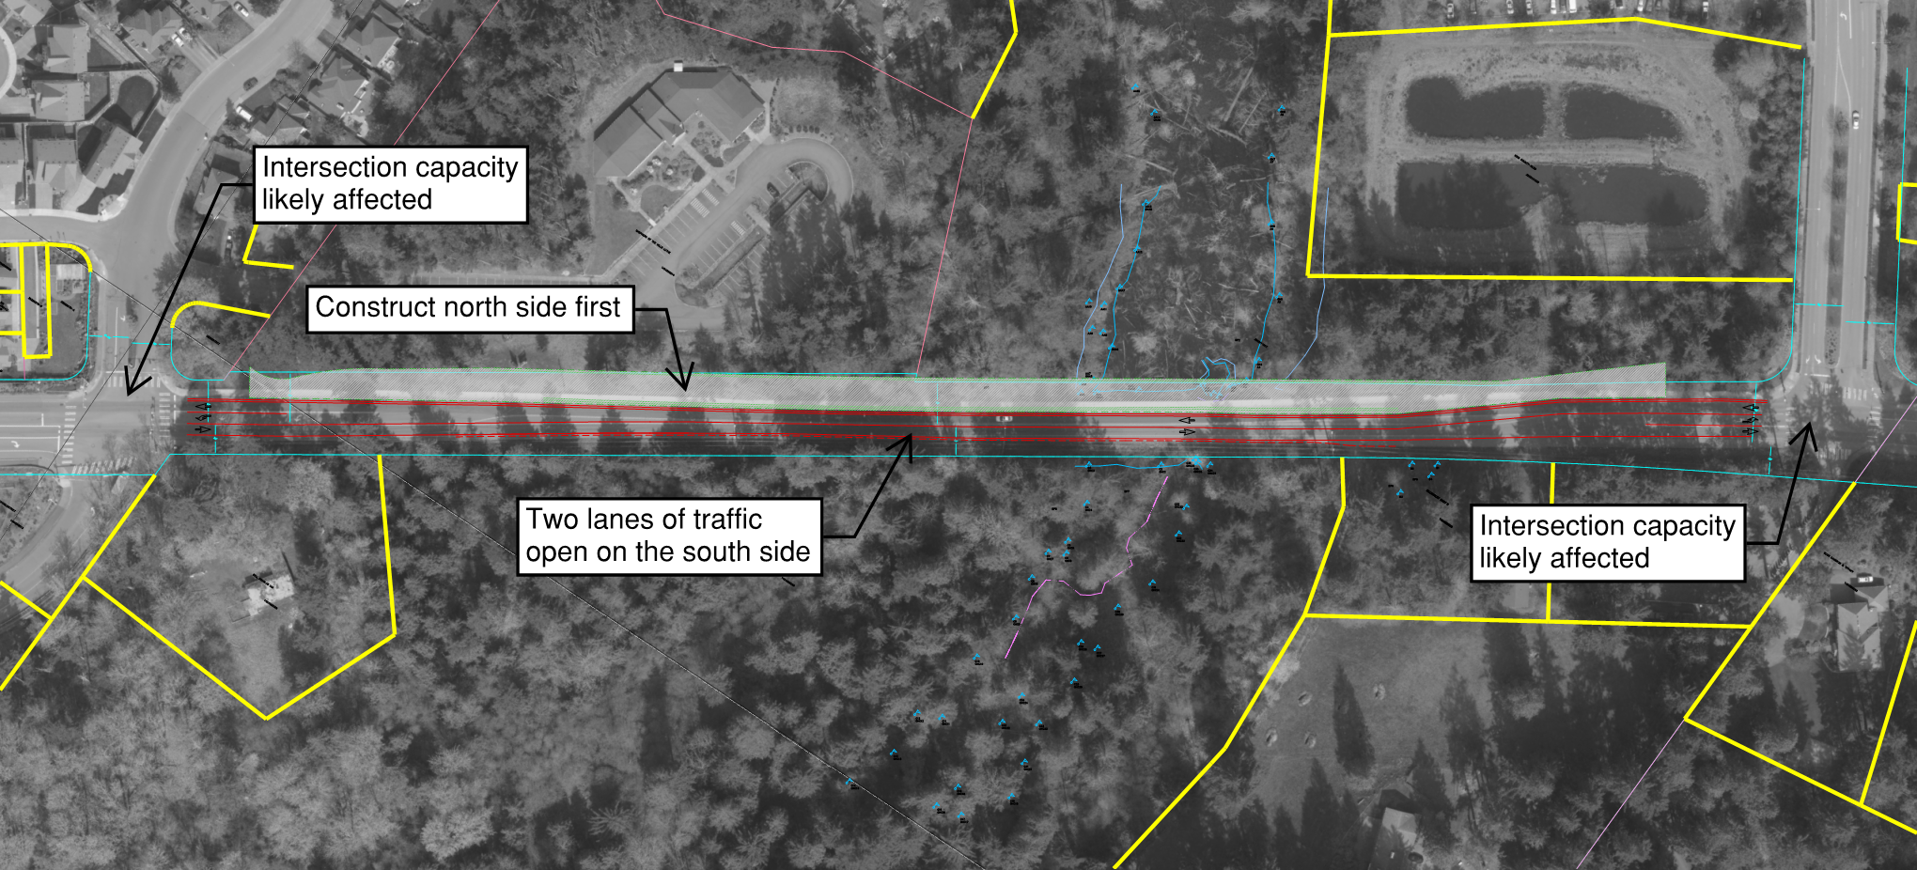
Potential Construction Staging
17
Notes:
KRISTINE
Welcome and introduce self and facilitator role
I first wanted to recognize any Council Members who have joined us this evening. If I can ask you to stand and wave, that would be great!
Also have quick introductions from the project team
From the City:
Sam Park, Project Manager
Steve Leniszewski, Director of Public Works
Cheryl Paston, Deputy Director of Public Works
Jim Grueber, Senior Project Engineer
Andrew Zagars, City Engineer
From HW Lochner, Consulting Engineer
Steve Lewis
Mark Burrus
Molly Toy
Rich Meredith
From EnviroIssues
(Kerri Franklin)
Kelly Foley – taking notes!

Slide 18
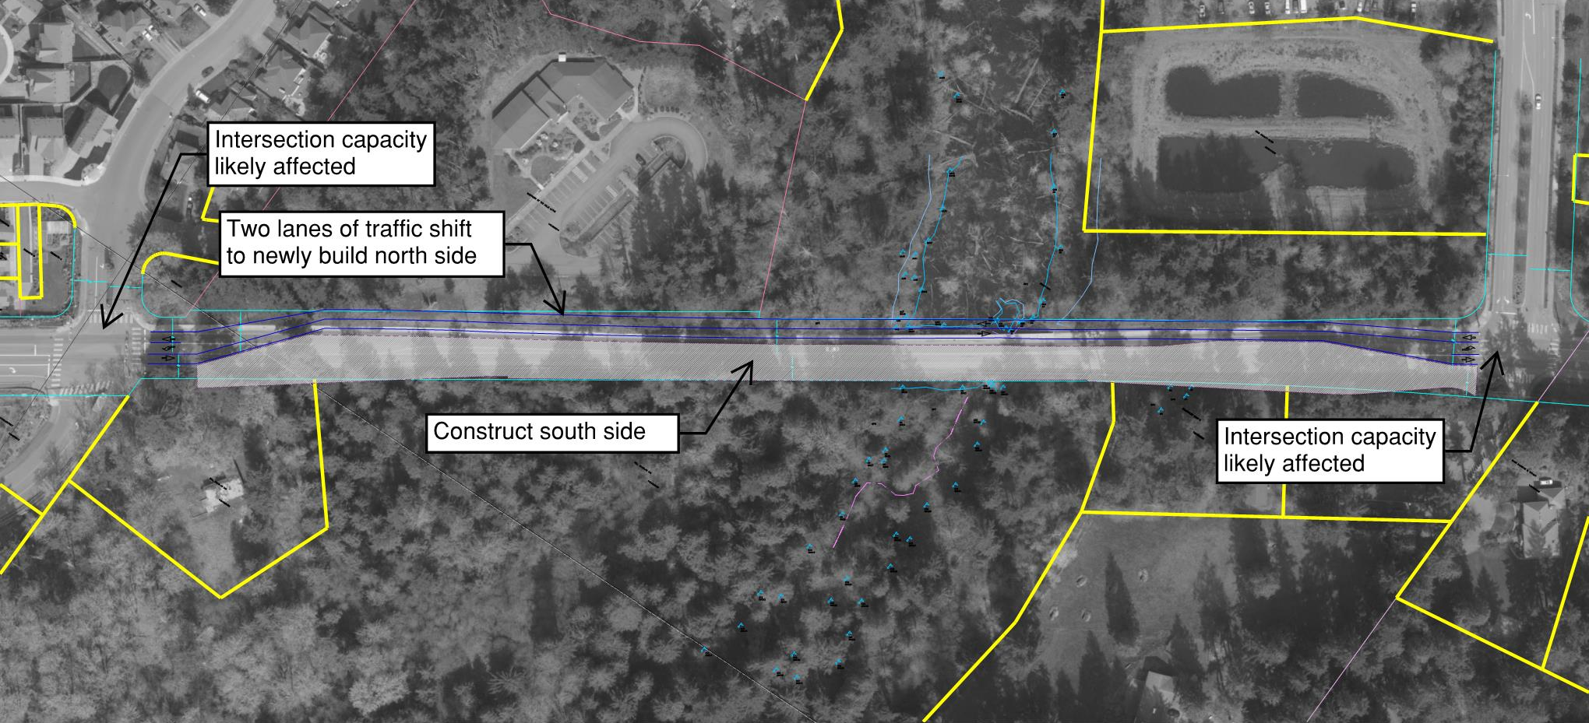
Potential Construction Staging
18
Notes:
KRISTINE
Welcome and introduce self and facilitator role
I first wanted to recognize any Council Members who have joined us this evening. If I can ask you to stand and wave, that would be great!
Also have quick introductions from the project team
From the City:
Sam Park, Project Manager
Steve Leniszewski, Director of Public Works
Cheryl Paston, Deputy Director of Public Works
Jim Grueber, Senior Project Engineer
Andrew Zagars, City Engineer
From HW Lochner, Consulting Engineer
Steve Lewis
Mark Burrus
Molly Toy
Rich Meredith
From EnviroIssues
(Kerri Franklin)
Kelly Foley – taking notes!

Slide 19
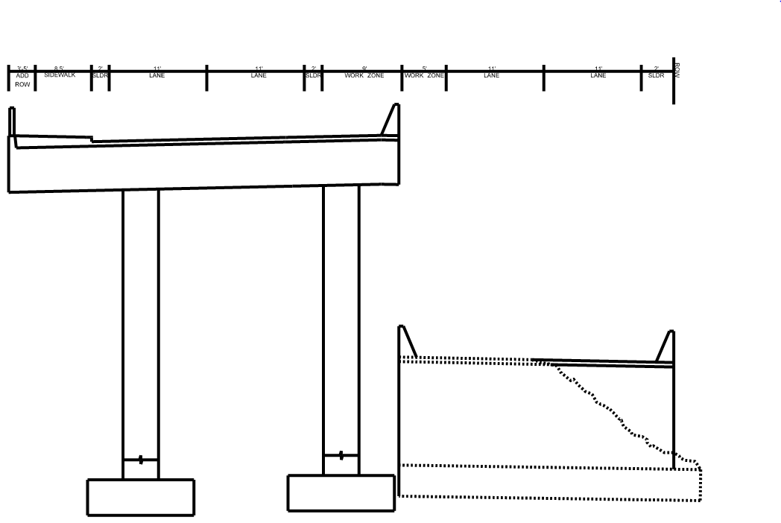
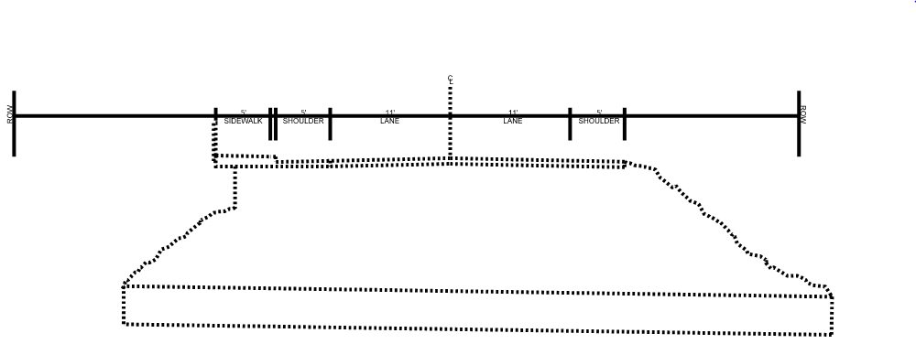
Potential Construction Staging
19
N
Existing Conditions
Construction Staging During Bridge Construction
Notes:
KRISTINE
Welcome and introduce self and facilitator role
I first wanted to recognize any Council Members who have joined us this evening. If I can ask you to stand and wave, that would be great!
Also have quick introductions from the project team
From the City:
Sam Park, Project Manager
Steve Leniszewski, Director of Public Works
Cheryl Paston, Deputy Director of Public Works
Jim Grueber, Senior Project Engineer
Andrew Zagars, City Engineer
From HW Lochner, Consulting Engineer
Steve Lewis
Mark Burrus
Molly Toy
Rich Meredith
From EnviroIssues
(Kerri Franklin)
Kelly Foley – taking notes!

Slide 20
Design Team Recommendations:
Two Options
20
Bridge: Staged Construction
Lower Impact
Longer Duration
Highest Cost
Easiest to Permit
Culvert: Full Closure
Higher Impact
Shorter Duration
Lowest Cost
Notes:
KRISTINE
Welcome and introduce self and facilitator role
I first wanted to recognize any Council Members who have joined us this evening. If I can ask you to stand and wave, that would be great!
Also have quick introductions from the project team
From the City:
Sam Park, Project Manager
Steve Leniszewski, Director of Public Works
Cheryl Paston, Deputy Director of Public Works
Jim Grueber, Senior Project Engineer
Andrew Zagars, City Engineer
From HW Lochner, Consulting Engineer
Steve Lewis
Mark Burrus
Molly Toy
Rich Meredith
From EnviroIssues
(Kerri Franklin)
Kelly Foley – taking notes!

Slide 21
COMPARISION: BRIDGE VS. CULVERT
21
Proposed Slope = ~6%
Notes:
KRISTINE
Welcome and introduce self and facilitator role
I first wanted to recognize any Council Members who have joined us this evening. If I can ask you to stand and wave, that would be great!
Also have quick introductions from the project team
From the City:
Sam Park, Project Manager
Steve Leniszewski, Director of Public Works
Cheryl Paston, Deputy Director of Public Works
Jim Grueber, Senior Project Engineer
Andrew Zagars, City Engineer
From HW Lochner, Consulting Engineer
Steve Lewis
Mark Burrus
Molly Toy
Rich Meredith
From EnviroIssues
(Kerri Franklin)
Kelly Foley – taking notes!

Slide 22
COMPARISION: BRIDGE VS. CULVERT
22
Construction Cost = $6.20M
Mitigation Cost = $0.40M
20 Year Life Cycle Cost = $0.08M
Additional Pavement Wear = $0.70M
Total Cost = $7.38M
Construction Length = 12 months
(road open, limited capacity)
Environmental Impacts = Low
Tribal Support = Preferred
Fill = 10,000 CY
Truck Loads = 15,000 TONS → >1000 Trucks
Construction Cost = $3.67M
Mitigation Cost = $0.60M
20 Year Life Cycle Cost = $0.25M
Additional Pavement Wear = $2.00M
Total Cost = $6.52M
Construction Length = 3 months
(road closed)
Environmental Impacts = Medium
Fill = 46,300 CY
Truck Loads = 90,800 TONS → >6000 Trucks
= 500, 15 TON loads
Notes:
KRISTINE
Welcome and introduce self and facilitator role
I first wanted to recognize any Council Members who have joined us this evening. If I can ask you to stand and wave, that would be great!
Also have quick introductions from the project team
From the City:
Sam Park, Project Manager
Steve Leniszewski, Director of Public Works
Cheryl Paston, Deputy Director of Public Works
Jim Grueber, Senior Project Engineer
Andrew Zagars, City Engineer
From HW Lochner, Consulting Engineer
Steve Lewis
Mark Burrus
Molly Toy
Rich Meredith
From EnviroIssues
(Kerri Franklin)
Kelly Foley – taking notes!

Slide 23
Next Steps
23
Council Decision on North Issaquah Creek Crossing February 7 CC Mtg.
Public Meeting #3 March/April 2017
30% Design Completion April 2017
Public Meeting (Detour Planning) June 2017
60% Design Completion September 2017
Project Bid Feb/March 2018
Project Construction Begins June 2018
Notes:
KRISTINE
Welcome and introduce self and facilitator role
I first wanted to recognize any Council Members who have joined us this evening. If I can ask you to stand and wave, that would be great!
Also have quick introductions from the project team
From the City:
Sam Park, Project Manager
Steve Leniszewski, Director of Public Works
Cheryl Paston, Deputy Director of Public Works
Jim Grueber, Senior Project Engineer
Andrew Zagars, City Engineer
From HW Lochner, Consulting Engineer
Steve Lewis
Mark Burrus
Molly Toy
Rich Meredith
From EnviroIssues
(Kerri Franklin)
Kelly Foley – taking notes!

Slide 24

Questions?
24
Notes:
KRISTINE
Welcome and introduce self and facilitator role
I first wanted to recognize any Council Members who have joined us this evening. If I can ask you to stand and wave, that would be great!
Also have quick introductions from the project team
From the City:
Sam Park, Project Manager
Steve Leniszewski, Director of Public Works
Cheryl Paston, Deputy Director of Public Works
Jim Grueber, Senior Project Engineer
Andrew Zagars, City Engineer
From HW Lochner, Consulting Engineer
Steve Lewis
Mark Burrus
Molly Toy
Rich Meredith
From EnviroIssues
(Kerri Franklin)
Kelly Foley – taking notes!

Slide 26
Decision Matrix

