Slide 1
SE 6th Street Improvement Project:
Project Update
City Council Study Session | February 10, 2026
Audrie Starsy, Public Works Director
Lei Wu, City Engineer

Slide 2
Presentation Overview
Capital Projects: Implementation of Adopted Plans
Project Overview
Project Progress
Proposed Scope Refinements
Schedule

Slide 3
Project Overview
Implementing adopted community plans
Site layout and background

Slide 4
Design & Construction: Implementing Community Plans
The SE 6th Street Improvements – Phase A Project (TR-134) included in the adopted:
  2024 Comprehensive Plan
  2024 Transportation Master Plan (TMP)
  2025-2030 Transportation Improvement Plan (TIP)
  2025-2030 Stormwater Improvement Plan (SWIP)
  2025-2030 Citywide Capital Improvement Plan
  2026-2031 Citywide Capital Improvement Plan
  2025-2026 Budget, and Mid-biennial Amended Budget
    Transportation Capital Fund
    Stormwater Capital Fund
Notes:
Implement the vision, goals, and policies from adopted community plans

Slide 5
Project Background
Planning Design Construction Maintenance
2008 Town Center Plan
2024 Comprehensive Plan, 2024 Transportation Master Plan
2025-2030 Transportation Improvement Plan, 2025-2030 Stormwater Improvement Plan
2025 Amended & Restated Development Agreement
2024-2025 Brownstones Design/Permitting (north half of SE 6th Street)
2025 Construction of north half of SE 6th Street
2025-2026 Design phase for south half of SE 6th Street
2026 Construction of south half of SE 6th Street
Street added to City Inspection & Maintenance Programs
Asset Rehabilitation, & Replacement
Notes:
Provide timeline of project background and the related community plans the project is implementing.

Slide 6
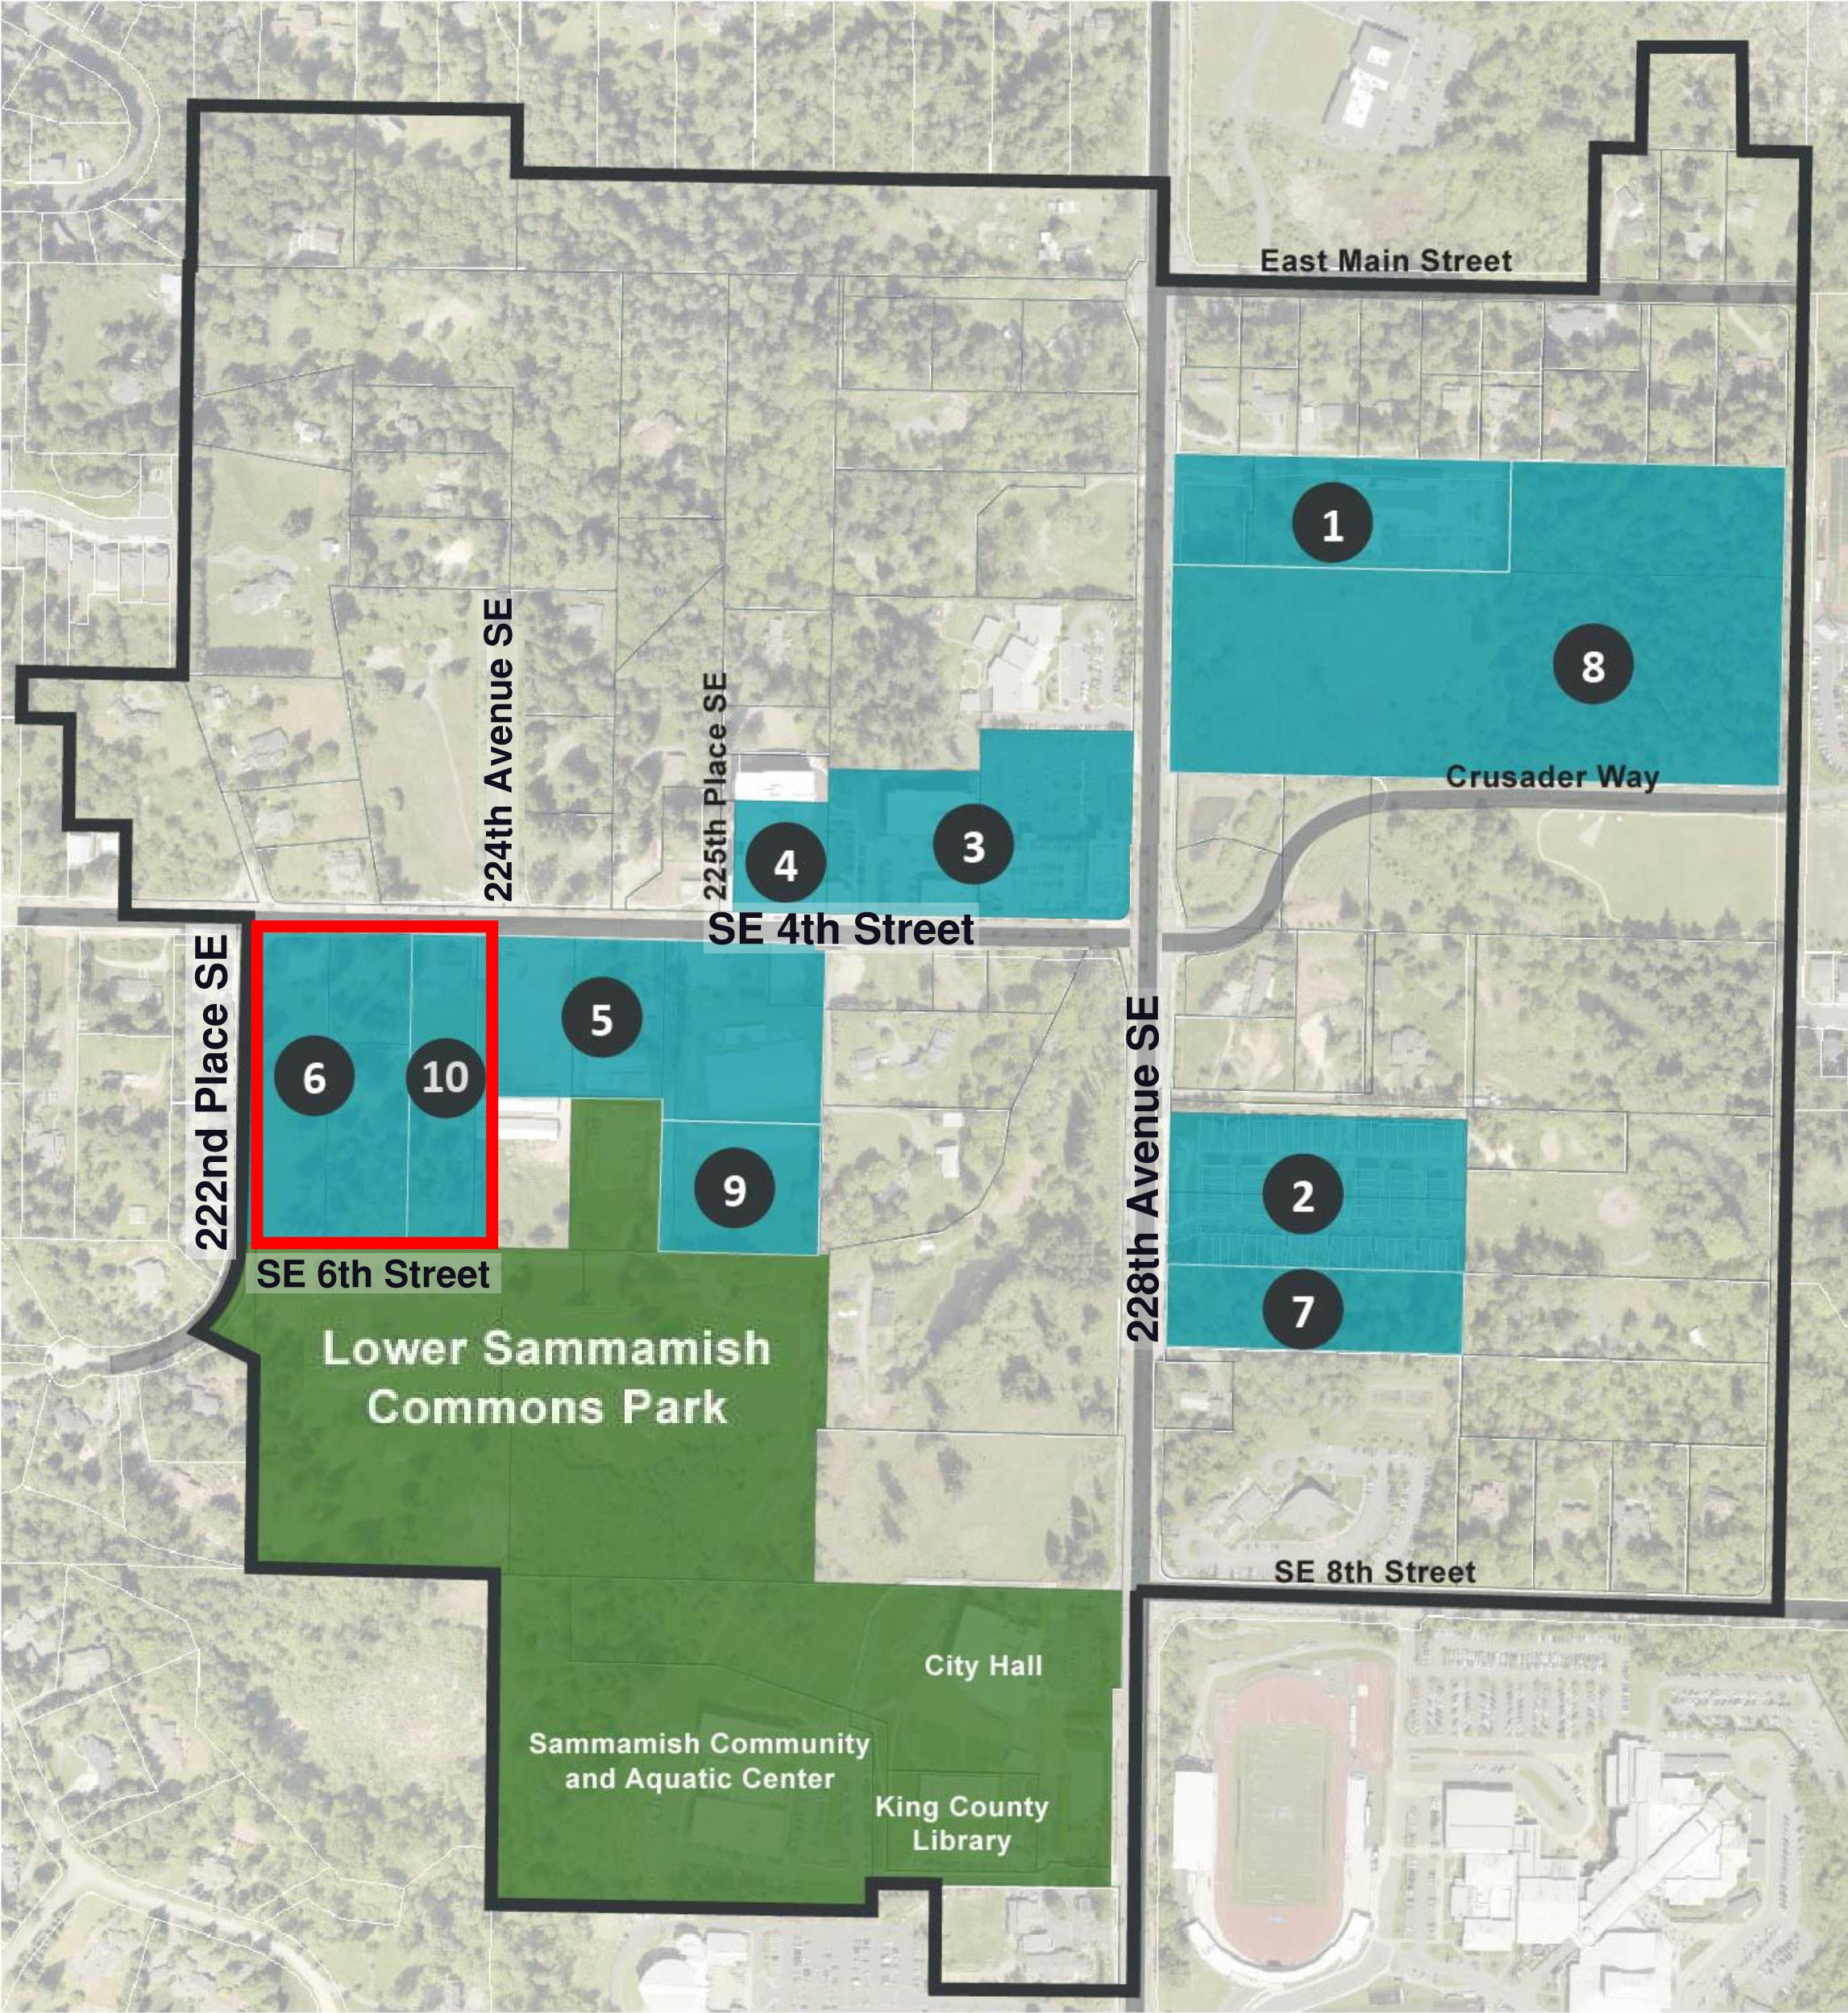
Sammamish Town Center Overview
Eight Planned Projects
  Commercial & Retail Space, Affordable Housing Units, Community Spaces, Transportation Infrastructure
  Private Developments
Town Center development map indicating location of eight projects that have been built or being permitted and planned.
Brownstones West (6), Brownstones East (10)
  Multi-family townhomes
  In construction - estimated completion 2026/2027
  Includes SE 6th Street, from 222nd Place SE to 224th Avenue SE
Notes:
Overview of project within Town Center

Slide 7
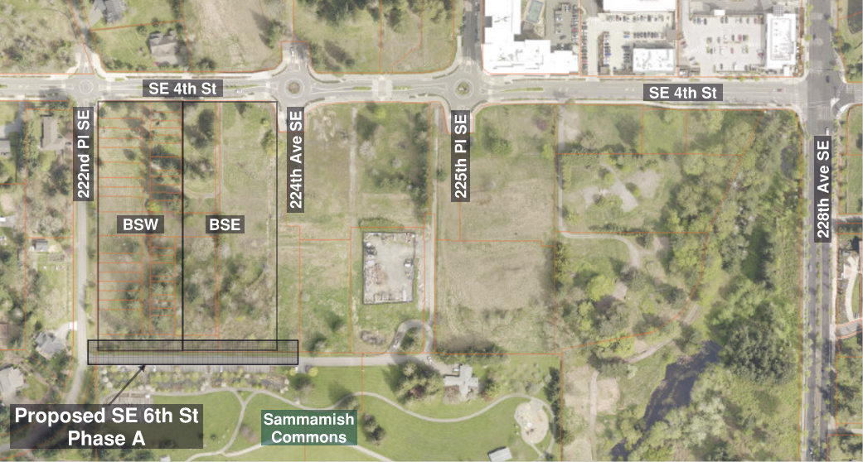
Project Location
2023 Aerial, King County iMap
Notes:
Project location for Phase A of the project

Slide 8
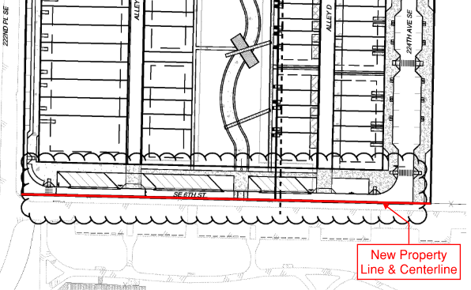
Development Agreement
Road centerline moved to property line
Integrates park entrance & parking with 6th Street
Developer designs & builds northern half
City designs & builds southern half
  Build off north half
  Separate stormwater design
SE 6th Street Modifications (Exhibit C from 2025 DA 2nd Amendment).
Notes:
The development agreement updates the current by fully integrating the park’s entrance and parking with 6th St.

Slide 9
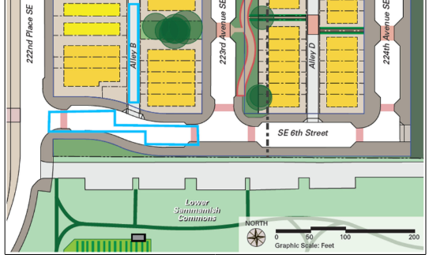
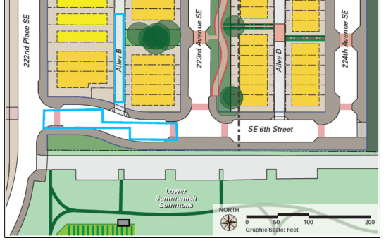
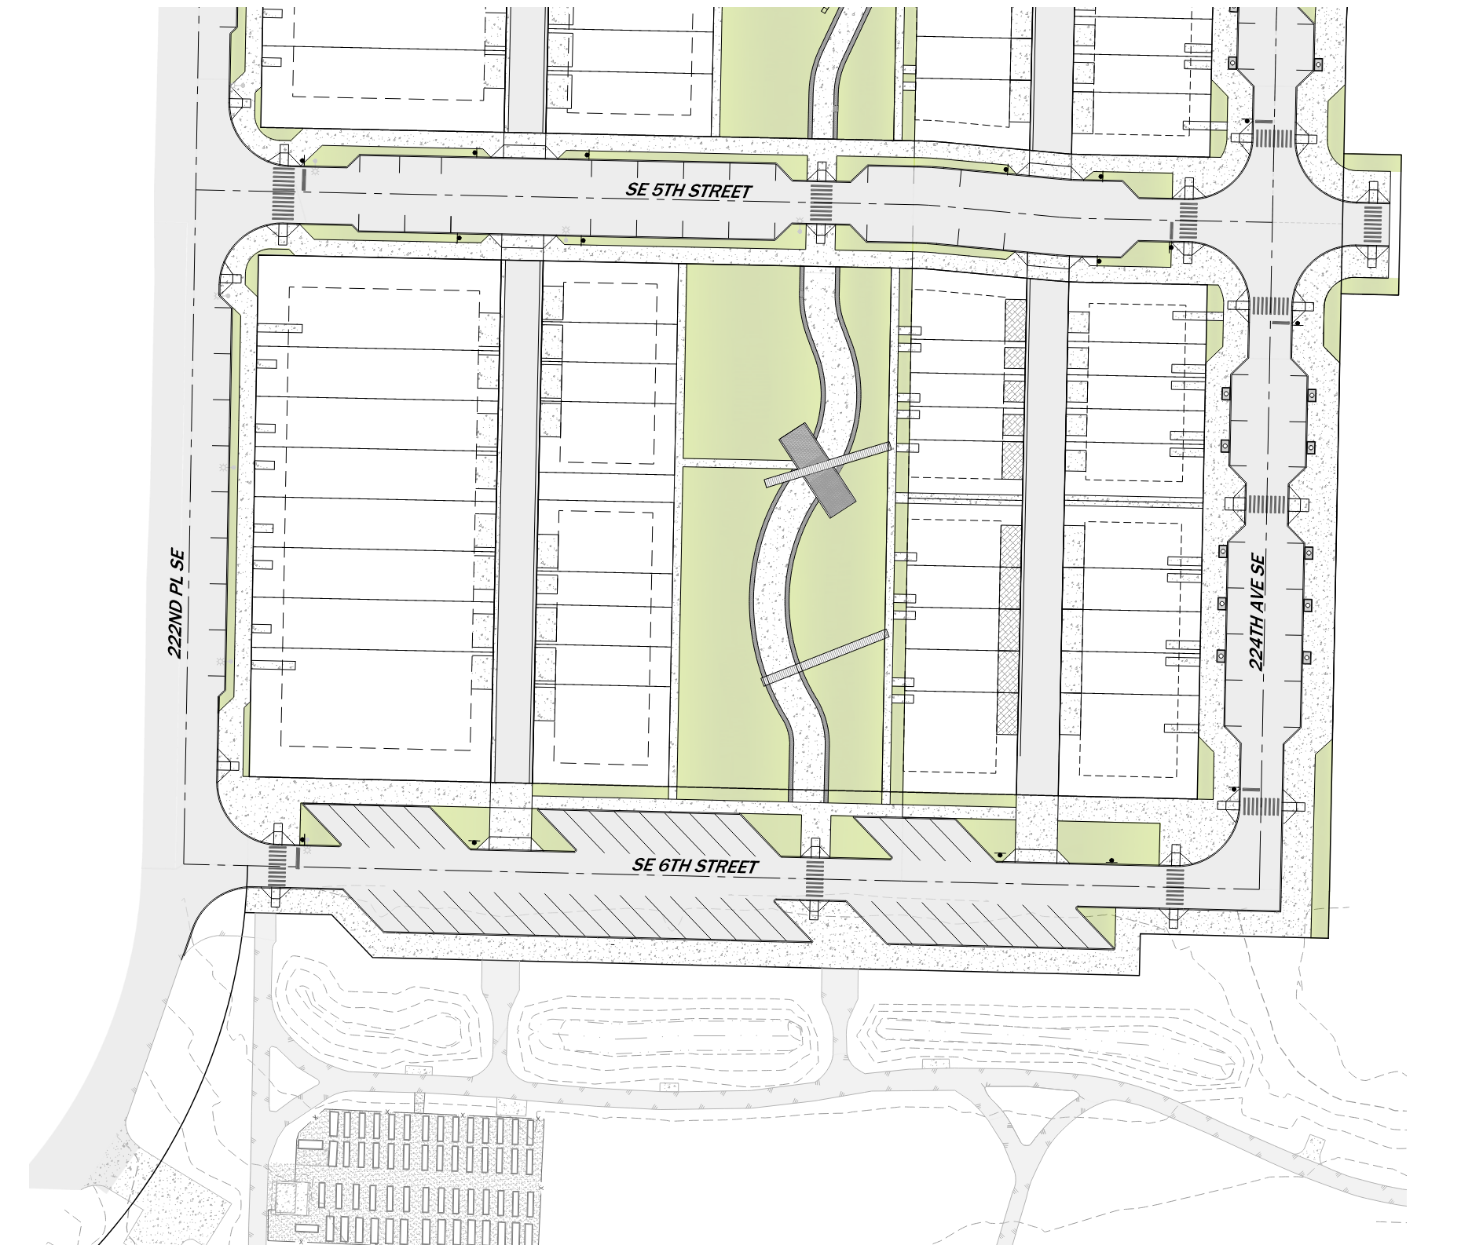
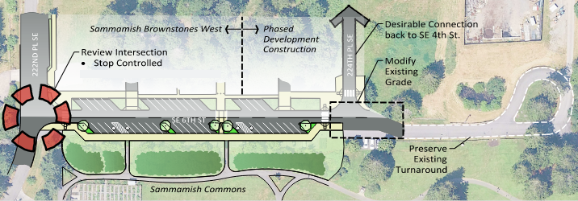
Community Benefits
Reduces:
  Access points onto 222nd and 6th
  Impervious surfaces
Increases:
  Multi-modal connectivity within Town Center
  Connectivity to retail, housing, and park
Preliminary site plan (Exhibit B from 2022 Developer Agreement).
Updated conceptual site plan (2025).
Notes:
Provides enhanced traffic connectivity in the Town Center.
Provides uninterrupted sidewalk along the northern edge of park.
Provide cohesive design that consolidates 6th St with the park’s parking area and drive aisle.
Reduces the number and complexity of intersections, thereby reducing driver decision making and reducing potential motorized and non-motorized conflicts.
Reduces ~10,000 sf of redundant impervious surface.
Reduces ~13,500 sf of pollution-generating areas.

Slide 10
Community Benefits
"Creation of a Town Center will require assertive action on the part of the City that
combines regulatory standards, public/private master planning, and both public and private
infrastructure investment"
(Source: Page 111, Town Center Plan)
Cohesive legacy design (versus island approach)
  Park becomes a part-of, instead of apart-from, Town Center
  Consolidates SE 6th Street right-of-way with the Lower Sammamish Commons Park parking area and drive aisle
  Future compatibility to broader vision for both the Park and Town Center
Reduces:
  access points onto 222nd and 6th
  potential conflicts of motorized and non-motorized movements
  impervious surface
Enhanced multi-modal connectivity within Town Center
Provides a large sidewalk along northern edge of Lower Sammamish Commons Park with enhanced pedestrian crosswalks connecting into new 223rd open space
Notes:
Describe how it ties into Town Center Plan and TMP goals:
The Town Center Plan laid out 7 Plan Elements, each with their own goals and policies. The elements are: Land Use, Transportation, Open Space Trails & Public Facilities, Natural Systems, Design, Housing, and Capital Facilities/utilities.
Goal T-1: Establish and maintain a connected hierarchy of streets that accommodates desired Town Center land uses and human activities.
Policy T-1.3: Develop a connected system of local access roads that serve planned Town Center development.
Goal T-2: Provide transportation facilities that create a unique character for the Town Center.
Goal T-3: Provide for Town Center Circulation while addressing safety and minimizing impacts to surrounding neighborhoods.
Policy T-3.1: Provide for a safe and convenient network of roadways to serve Town Center development.
Goal T-5: Create an attractive, safe, and convenient road and trail network that promotes walking, bicycling, and other non-motorized forms of transportation.
T-5.1: Develop a connected street/sidewalk and trail system.
Goal T-6: Provide parking in the Town Center appropriate to accommodate desired uses.

Slide 11
Project Update
Northern half of SE 6th Street
Southern half of SE 6th Street

Slide 12
Status: Northern Half of SE 6th Street
Design completed
Construction is substantially complete:
  Underground utilities
  Base asphalt lift
  Streetlights
  Sidewalks/curb ramps
  Signage
Remaining construction:
  Final lift of asphalt, dependent on developer's building construction timeline
  Punchlist items (to be done)
Notes:
Remaining work items for north half: Top lift of HMA and channelization.

Slide 13
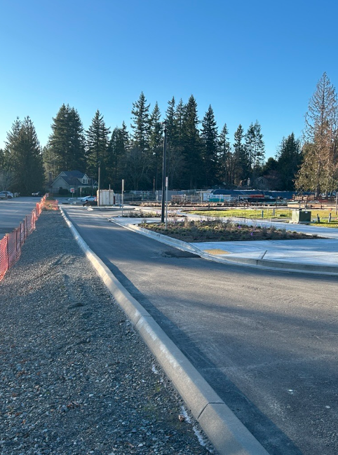
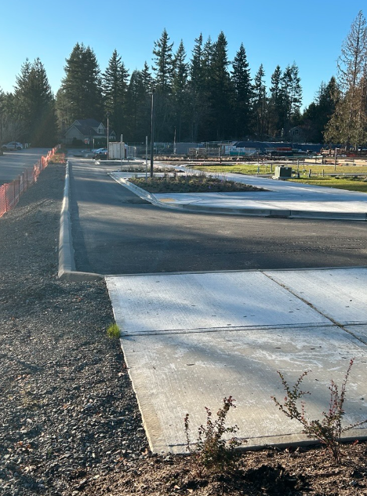
Northern Half of SE 6th Street
Looking west from 224th Ave SE
2/10/2026
Notes:
Remaining work items for north half: Top lift of HMA and channelization.

Slide 14
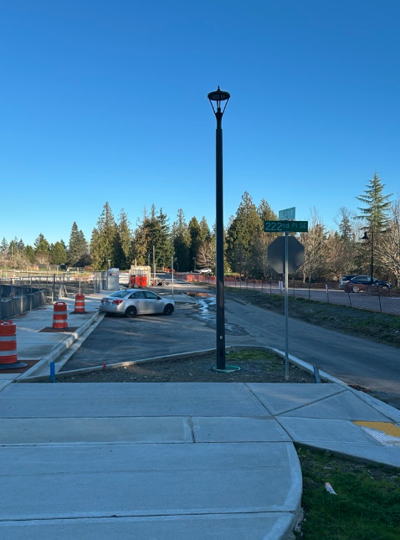
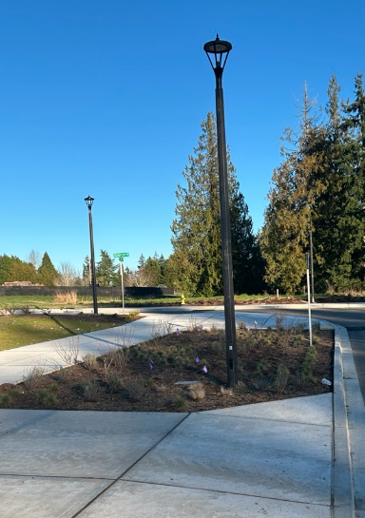
Northern Half of SE 6th Street
Looking east from 222nd Pl SE (photo right) and near 224th Ave NE & SE 6th Street (photo left).
2/10/2026
Notes:
Remaining work items for north half: Top lift of HMA and channelization.

Slide 15
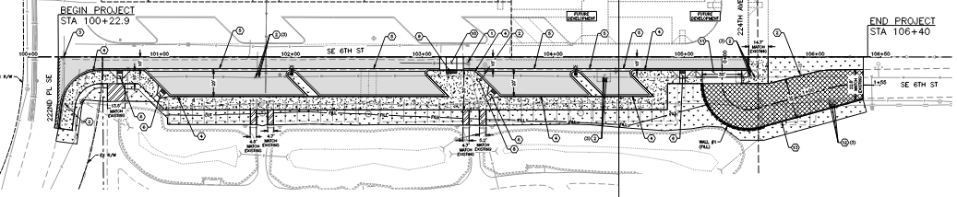
Status: Southern Half of SE 6th Street
30% design complete
Final design completion - June 2026
  Details refined between 30-100% design
  Access management to be shared with community at City Council meeting for construction contract award (July)
Construction start – August 2026
Site plan from 30% Design Submittal.
Notes:
Balance construction project needs and public access to park during construction.

Slide 16
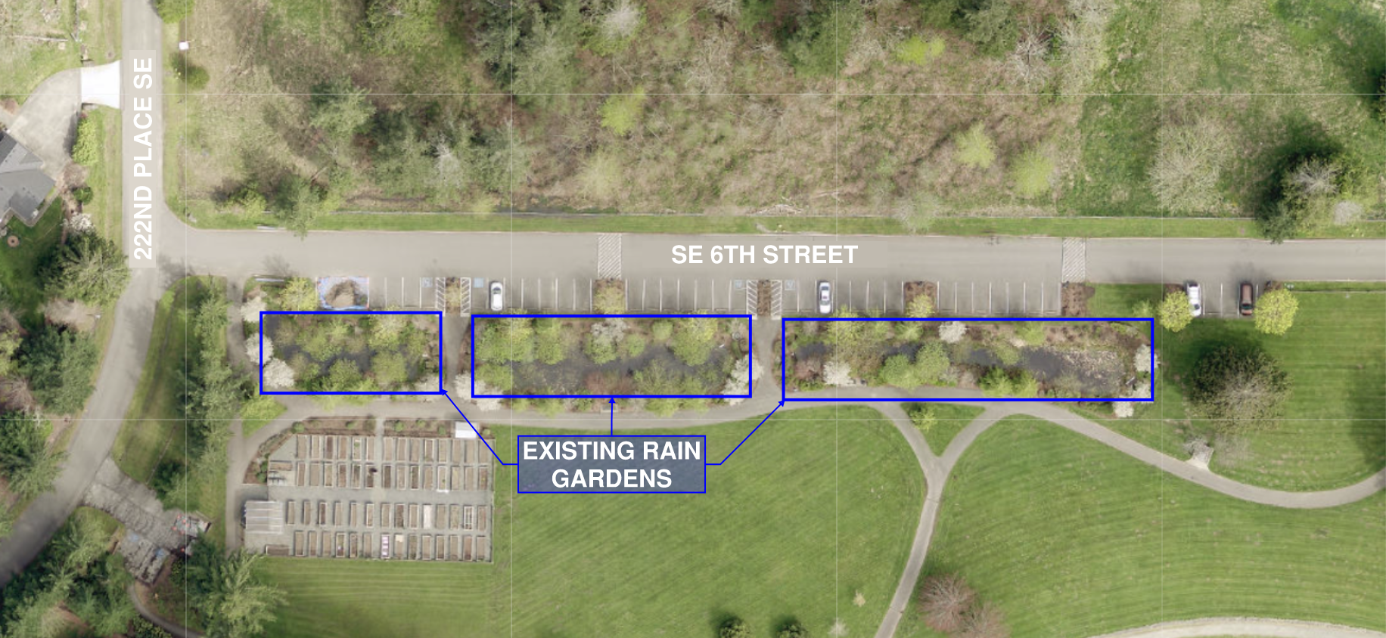
Contract Approval Request Coming Up
Renew the contract, expired at the end of 2025
Scope refinement
  Updated stormwater Technical Information Report (TIR) to save the rain gardens
  Construction bid and advertisement support
  Approx. $50,000 additional
Notes:
Added tasks for updated Stormwater TIR and bid support
Updated schedule of prices for remaining work

Slide 17
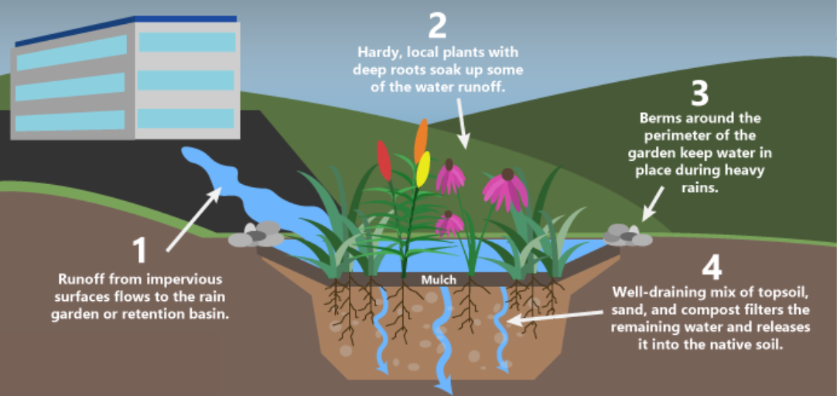
Benefits of Rain Gardens
Reduced flooding & erosion
Improved water quality
Groundwater recharge
Cost-effective infrastructure
Provides micro-habitats for wildlife
Provides resiliency for stormwater management
Is considered a Low-Impact Development (LID), which is a preferred method of managing stormwater by mimicking natural hydrologic conditions
Notes:
Rain gardens slow down and capture runoff from impervious surfaces, reducing the volume of water entering storm drains.
They improved water quality by filtering out pollutants such as oil from runoff.
They allow water to percolate into the soil and replenish the groundwater supply rather than just running off.
They offer a lower-cost alternative to traditional drainpipes and sewer systems.

Slide 18
Project Budget: SE 6th Street Improvements, Phase A
$2.55M project budget (design, permitting, construction, etc.)
Original design contract: $336,000
  Spent to date: $90,000
New contract amount includes
  100% design, bid package
  Approx. $50,000 additional funding for stormwater, construction advertisement support

Slide 19
Schedule
2026
Northern Half Substantially Complete
Contract Renewal Approval
ROW
Dedication
Begin Construction
Complete Construction
90% Design Complete
Construction Contract Ad
Jan
Feb
Mar
Apr
May
Jun
Jul
Aug
Sep
Oct
Nov
Study Session: Project Update
100% Design Complete
Contract Award

Slide 20
Upcoming Project Milestones & Council Meetings
Design Contract award (Feb. 17)
90% Design Complete (April)
ROW dedication to align with use (June)
100% Design Complete (June)
Construction Contract Award (July)
Ground-Breaking Ceremony (August)
Construction Substantially Complete (November)
Ribbon-cutting Ceremony (To Be Determined)
Construction Project Acceptance (December)
*Bold text indicates Council/community meetings

Slide 21
Thank you
Audrie Starsy, Public Works Director
Lei Wu, City Engineer

Slide 22
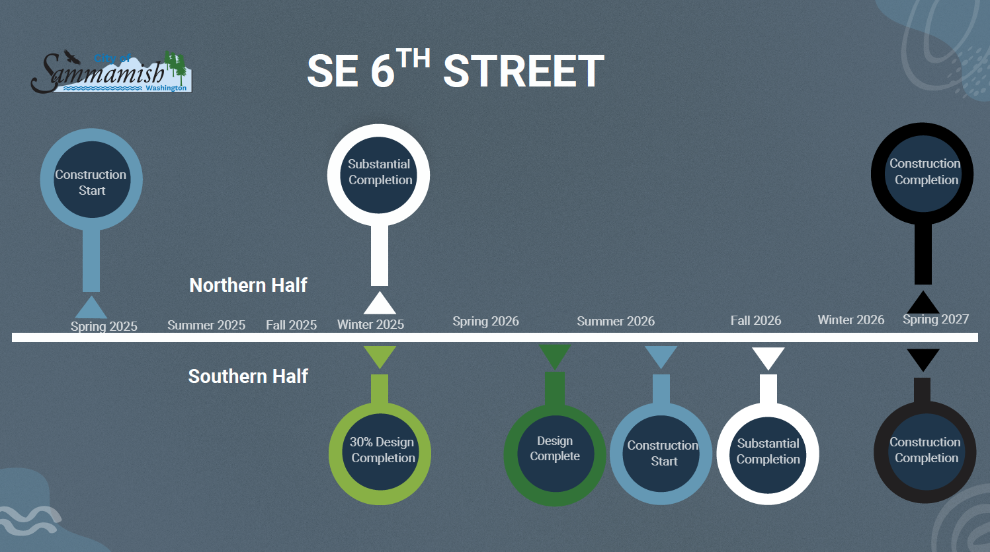

Slide 23
Role of Capital Projects
Capital Projects:
Implement the vision, goals, and policies from adopted community plans
  Town Center Plan
  Comprehensive Plan
  Transportation Master Plan
Invest in infrastructure to connect and support the community
Enhance quality of life

Slide 24
Implementing Town Center Plan Goals
Town Center Goals
Project Outcomes
T.1: Establish & maintain connectivity & multimodal network
T-5: Create an attractive, safe, & convenient roadway that promotes walking, non-motorized forms of transportation.
T-6: Provide parking in the Town Center appropriate to accommodate desired uses.
T-2: Provide transportation facilities that create a unique character for the Town Center.
T-3: Provide circulation, minimize impacts to surrounding neighborhoods
Enhanced Traffic Flow & Non-Motorized Transportation
Maintains a harmonious relationship to the natural surroundings
Promotes walking, bicycling, and other non-motorized forms of transportation
Increased Accessibility, easier for residents and visitors to access shops, services, and amenities
Strengthened Town Identity, Sense of Place
Notes:
Describe how it ties into Town Center Plan and TMP goals:
The Town Center Plan laid out 7 Plan Elements, each with their own goals and policies. The elements are: Land Use, Transportation, Open Space Trails & Public Facilities, Natural Systems, Design, Housing, and Capital Facilities/utilities.
Goal T-1: Establish and maintain a connected hierarchy of streets that accommodates desired Town Center land uses and human activities.
Policy T-1.3: Develop a connected system of local access roads that serve planned Town Center development.
Goal T-2: Provide transportation facilities that create a unique character for the Town Center.
Goal T-3: Provide for Town Center Circulation while addressing safety and minimizing impacts to surrounding neighborhoods.
Policy T-3.1: Provide for a safe and convenient network of roadways to serve Town Center development.
Goal T-5: Create an attractive, safe, and convenient road and trail network that promotes walking, bicycling, and other non-motorized forms of transportation.
T-5.1: Develop a connected street/sidewalk and trail system.
Goal T-6: Provide parking in the Town Center appropriate to accommodate desired uses.

Slide 25
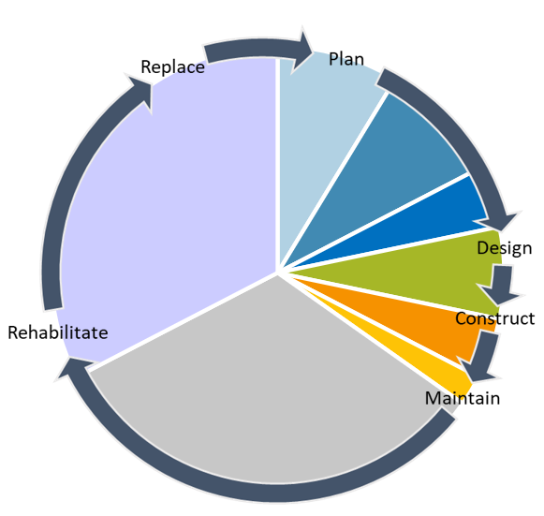
More Information or Questions?
Project Team:
Joe Dapcevich, Associate Engineer & Project Manager: jdapcevich@sammamish.us
Kathryn Hoffman, Associate Engineer: khoffmann@sammamish.us
Capital Plan Phase/Effort | How to Engage or Learn More:
2024 Transportation Master Plan | City webpage:
Town Center Plan | City Council meetings, Planning Commission meetings, City webpage
6-year Citywide Capital Improvement Plans | City Council meetings, City webpage: https://www.sammamish.us/government/public-works/transportation-planning/improvement-programs/
Design Phase | Project Open Houses, Council meetings (Contract Award & Milestones) Project webpage: www.sammamish.us/projects/se-6th-street-improvements
Construction Phase | Project Info (schedule, budget, progress): project webpage Traffic impacts (road closures or delays): Sammamish Cone Zone Noise/Erosion Concerns: MySammamish (online request portal)
Maintenance Phase | Traffic impacts (road closures or delays): Sammamish Cone Zone Concerns about infrastructure: MySammamish (online request portal) Maintenance Maps: https://www.sammamish.us/government/public-works/

