Slide 1
CITY OF SAMMAMISH
PUBLIC OPEN HOUSE
TRANSIT PLAN
JUNE 29, 2023
DOUG MCINTYRE
SR TRANSPORTATION PLANNING MANAGER
(425) 295-0628 • DMcIntyre@sammamish.us

Slide 2
Tonight’s Agenda
Welcome and Introductions
Presentation
Project Background
Existing Conditions
Project Schedule
How to use Social Pinpoint
Public Input
Notes:
Speaker: Thomas

Slide 3
WELCOME!
Doug McIntyre, AICP
SR TRANSPORTATION PLANNING MANAGER
(425) 295-0628 • DMcIntyre@sammamish.us
TEXT SLIDE WITH A NUMBERED LIST
Sarah Keenan, PE
SR TRAFFIC ENGINEER
(206) 436-0600 • SBK@DKSAssociates.com
Kendall Flint
SR Community Engagement Specialist
(650) 455-1201 • Kendall.Flint@DKSAssociates.com
3

Slide 4
Project Background

Slide 5
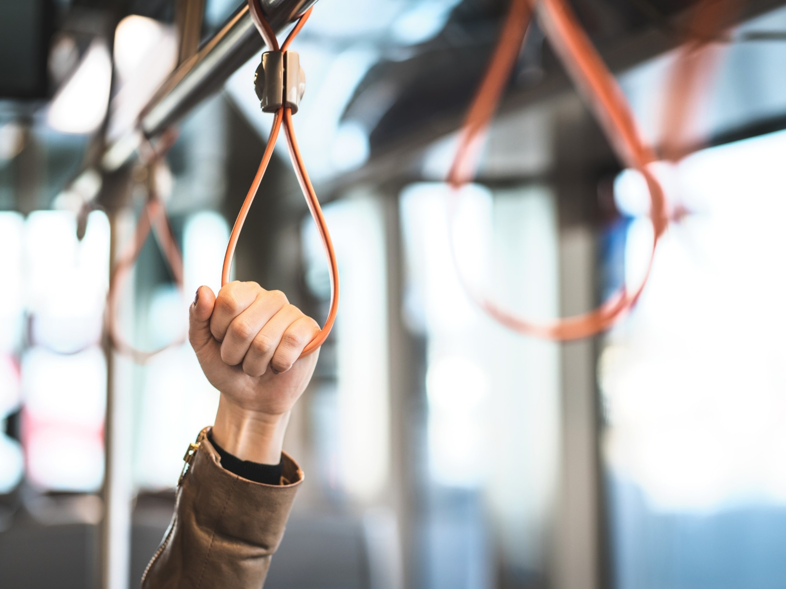
What is a Transit Plan?
A comprehensive approach to understanding how transit serves Sammamish residents and how it can be improved to meet current and future needs.
Service - Current and Future demand for transit​
Capital - Prioritized investments​
Policy - The framework and vision for transit
5

Slide 6
Transit Plan Topic Areas – Service Planning
Existing Conditions Report | Level of Service Measures | Planned Transit Network
Summarize the existing plans, existing service, and existing access to service overlaid with existing demographics and commute data | Identify a set of performance measures that capture the effectiveness of transit service | Consider areas of planned growth to identify deficiencies in service and access to services for desired commute patterns

Slide 7
Transit Plan Topic Areas – Capital Planning
Transit-Supportive Capital Projects​ | Barriers and Recommendations​ | Planning Level Cost Estimates​
Identify capital projects to improve the City’s transit system with a goal to improve transit speed and reliability​ | Recommendations for the proposed transit network and access to transit​ | List of short- and long-term capital projects with planning level cost estimates​

Slide 8
Transit Plan Topic Areas – Policy Planning
Policy Framework and Implementation | Equity Analysis
Identify policy gaps and ways to address them in the Comprehensive Plan Update | Identify the needs and concerns of all underserved communities across the spectrum of socio-economic diversity

Slide 9
Existing Conditions

Slide 10
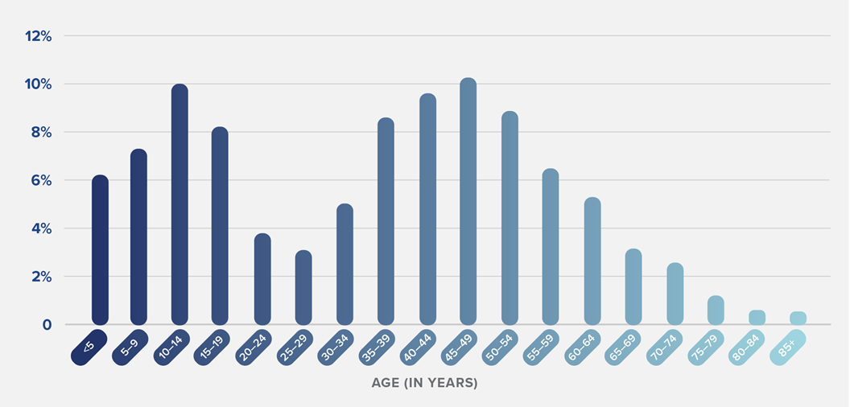
DEMOGRAPHIC DATA (2021)
10

Slide 11
EXISTING POPULATION DENSITY (2021)

Slide 12
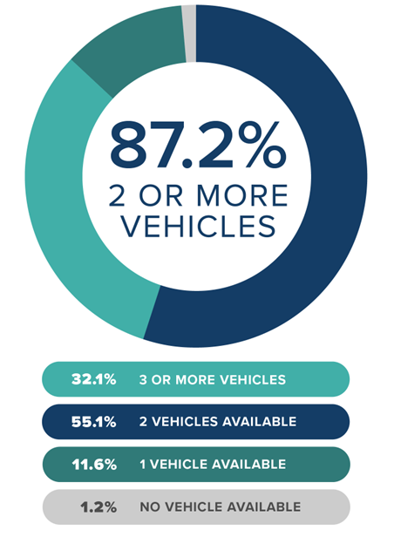
ZERO VEHICLE HOUSEHOLDS (2021)
12

Slide 13
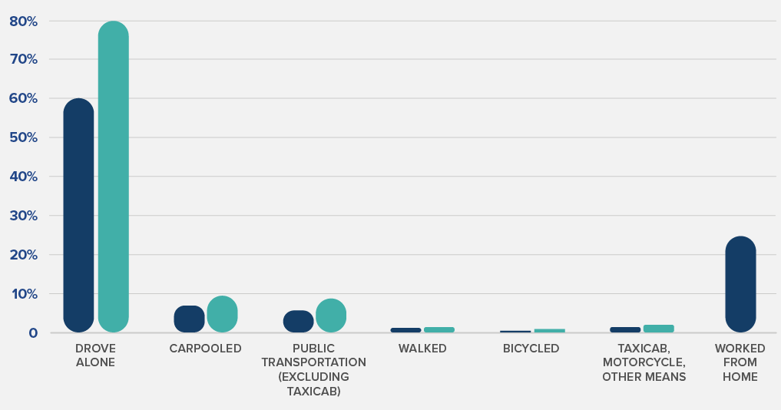
EXISTING COMMUTE PATTERNS (2021)

Slide 14
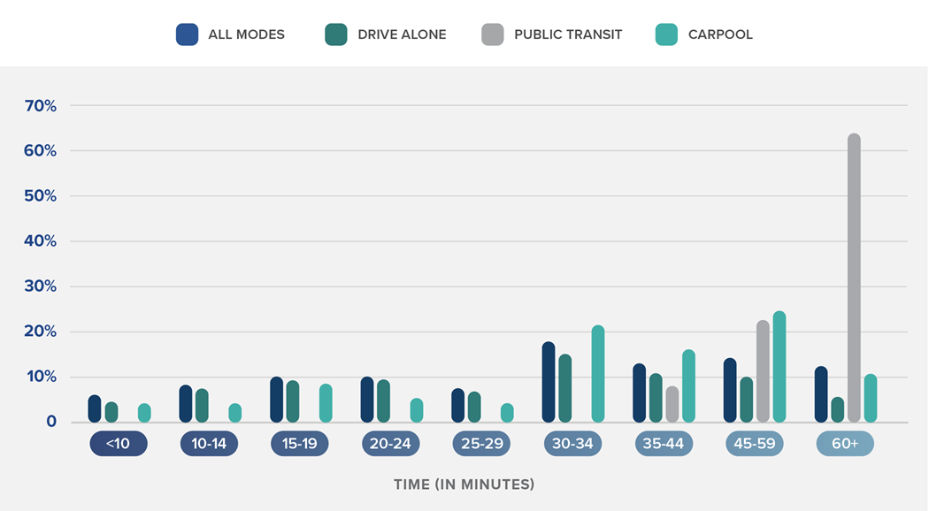
EXISTING COMMUTE PATTERNS (2021)
14

Slide 15
EXISTING TRANSIT (2023)
Terminates in Seattle
Terminates in Seattle
15

Slide 16
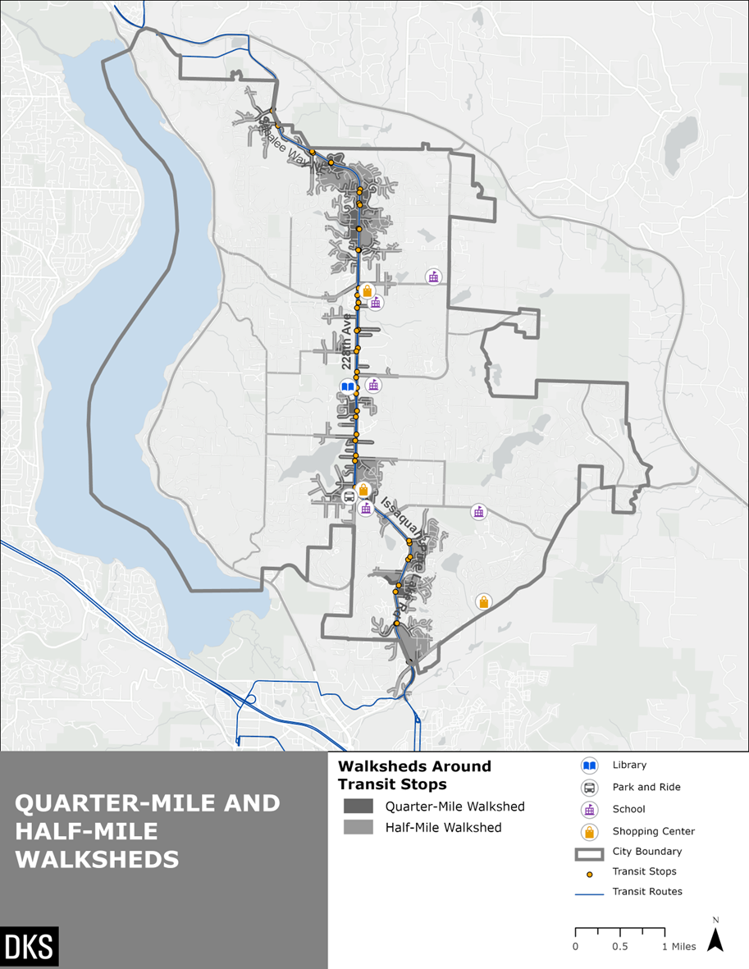
EXISTING POPULATION WALKSHED (2020)
 | Access to Transit
Area | Total Population (2020) | Total Jobs (2020)
1/4-Mile Walkshed | 6% | 11%
1/2-Mile Walkshed | 14% | 26%

Slide 17
EXISTING RIDERSHIP (2022)
17

Slide 18
TRANSIT DATA (2023)
18

Slide 19
TRANSIT DELAY- ROUTE 269 (2021)
19

Slide 20
Schedule

Slide 21
SCHEDULE?
Existing Conditions
Future Needs & Capital
Projects
Spring
2023
Summer
2023
Fall
2023
TODAY!
Workshop: Present Existing Conditions & Solicit Feedback
Adoption
21

Slide 22
Public Input and Social Pinpoint

Slide 23
PROJECT WEBSITE
23
Notes:
https://www.sammamish.us/government/public-works/transportation-planning/sammamish-transit-plan/

Slide 24
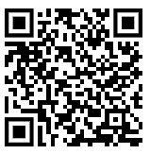
Social Pinpoint
https://bit.ly/SammamishTransit
24
Notes:
https://www.sammamish.us/government/public-works/transportation-planning/sammamish-transit-plan/

Slide 25
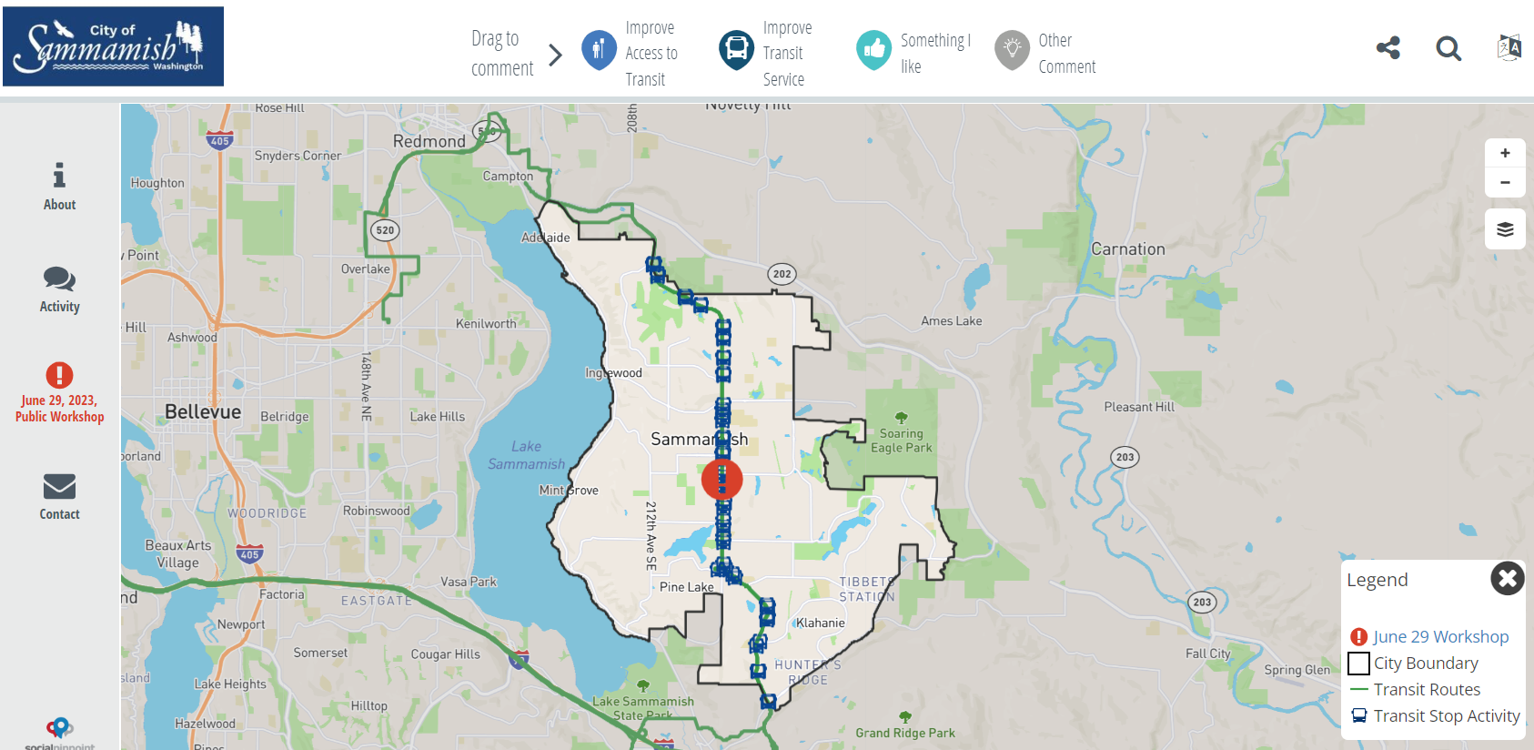
Change Language (133 choices)
Social Pinpoint
Zoom in and out
25
Notes:
https://www.sammamish.us/government/public-works/transportation-planning/sammamish-transit-plan/

Slide 26
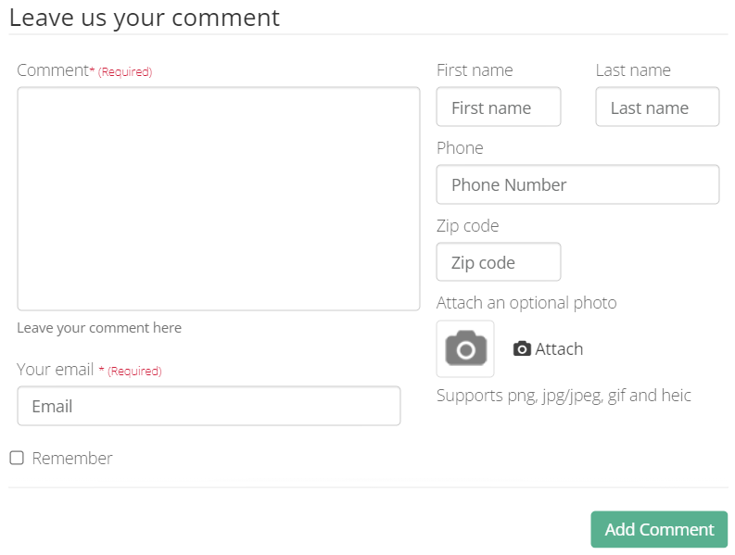
Drag a Comment
Social Pinpoint
Add a Photo
26
Notes:
https://www.sammamish.us/government/public-works/transportation-planning/sammamish-transit-plan/

Slide 27
LIVE POLLING!
27
Notes:
https://www.sammamish.us/government/public-works/transportation-planning/sammamish-transit-plan/

Slide 28
Questions
&
Answers
28
Notes:
Speaker: Veronica
WE have 1 hour for Questions and Comments
Search for COMMON THEMES
we may not have time to address every question,

Slide 29
THANK YOU

