Slide 1

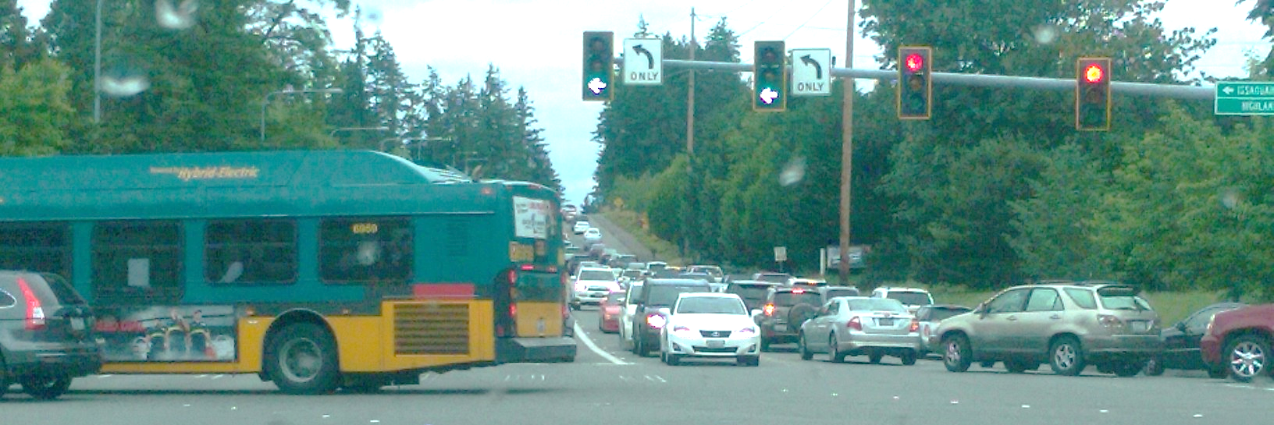

Issaquah-Fall City Road Improvements Project
Phase I Design
City Council Update
Notes:
KRISTINE
Welcome and introduce self and facilitator role
I first wanted to recognize any Council Members who have joined us this evening. If I can ask you to stand and wave, that would be great!
Also have quick introductions from the project team
From the City:
Sam Park, Project Manager
Steve Leniszewski, Director of Public Works
Cheryl Paston, Deputy Director of Public Works
Jim Grueber, Senior Project Engineer
Andrew Zagars, City Engineer
From HW Lochner, Consulting Engineer
Steve Lewis
Mark Burrus
Molly Toy
Rich Meredith
From EnviroIssues
(Kerri Franklin)
Kelly Foley – taking notes!

Slide 2
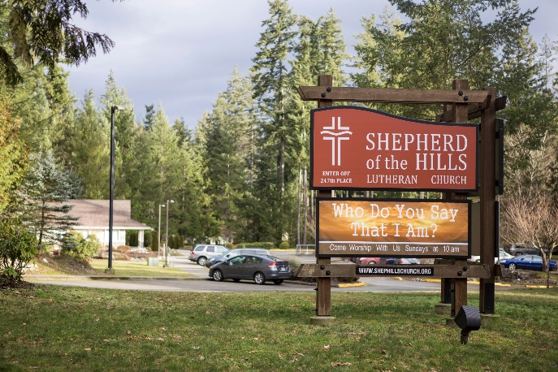
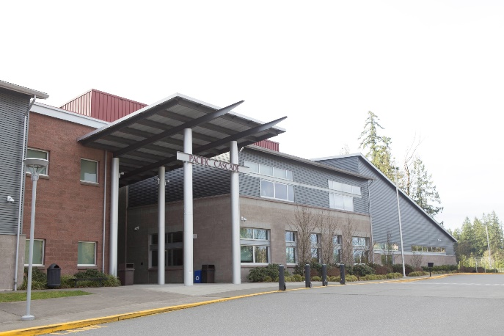
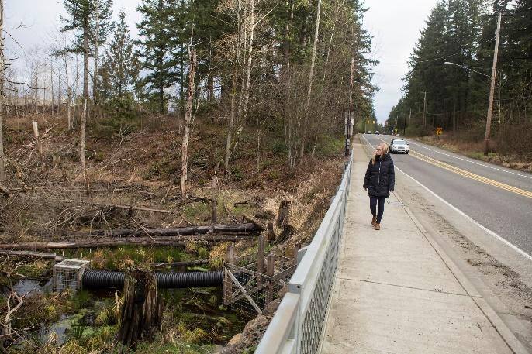
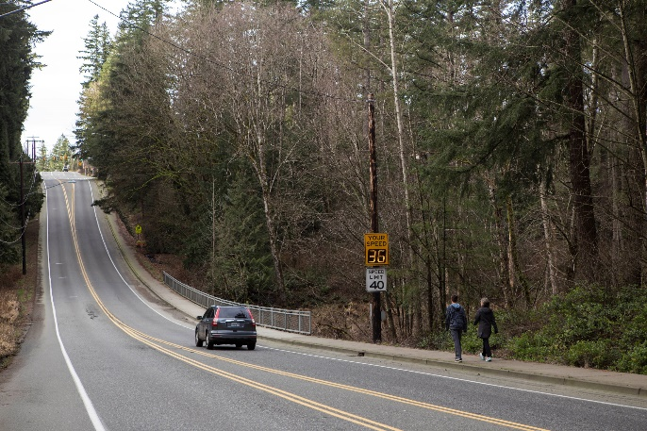
Meeting Agenda
2
Project Overview
Focus for Tonight
Direction from Council
Notes:
KRISTINE
Welcome and introduce self and facilitator role
I first wanted to recognize any Council Members who have joined us this evening. If I can ask you to stand and wave, that would be great!
Also have quick introductions from the project team
From the City:
Sam Park, Project Manager
Steve Leniszewski, Director of Public Works
Cheryl Paston, Deputy Director of Public Works
Jim Grueber, Senior Project Engineer
Andrew Zagars, City Engineer
From HW Lochner, Consulting Engineer
Steve Lewis
Mark Burrus
Molly Toy
Rich Meredith
From EnviroIssues
(Kerri Franklin)
Kelly Foley – taking notes!

Slide 3
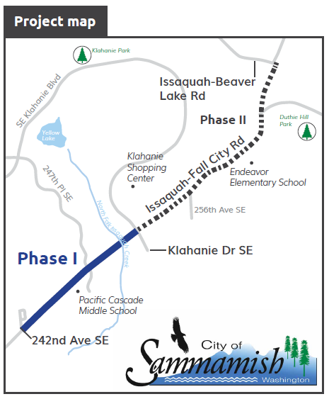

Project Overview
3
Notes:
KRISTINE
Welcome and introduce self and facilitator role
I first wanted to recognize any Council Members who have joined us this evening. If I can ask you to stand and wave, that would be great!
Also have quick introductions from the project team
From the City:
Sam Park, Project Manager
Steve Leniszewski, Director of Public Works
Cheryl Paston, Deputy Director of Public Works
Jim Grueber, Senior Project Engineer
Andrew Zagars, City Engineer
From HW Lochner, Consulting Engineer
Steve Lewis
Mark Burrus
Molly Toy
Rich Meredith
From EnviroIssues
(Kerri Franklin)
Kelly Foley – taking notes!

Slide 4
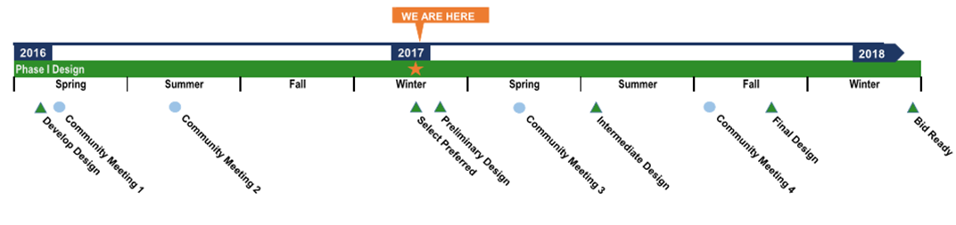
Project Timeline
4
Notes:
KRISTINE
Welcome and introduce self and facilitator role
I first wanted to recognize any Council Members who have joined us this evening. If I can ask you to stand and wave, that would be great!
Also have quick introductions from the project team
From the City:
Sam Park, Project Manager
Steve Leniszewski, Director of Public Works
Cheryl Paston, Deputy Director of Public Works
Jim Grueber, Senior Project Engineer
Andrew Zagars, City Engineer
From HW Lochner, Consulting Engineer
Steve Lewis
Mark Burrus
Molly Toy
Rich Meredith
From EnviroIssues
(Kerri Franklin)
Kelly Foley – taking notes!

Slide 5
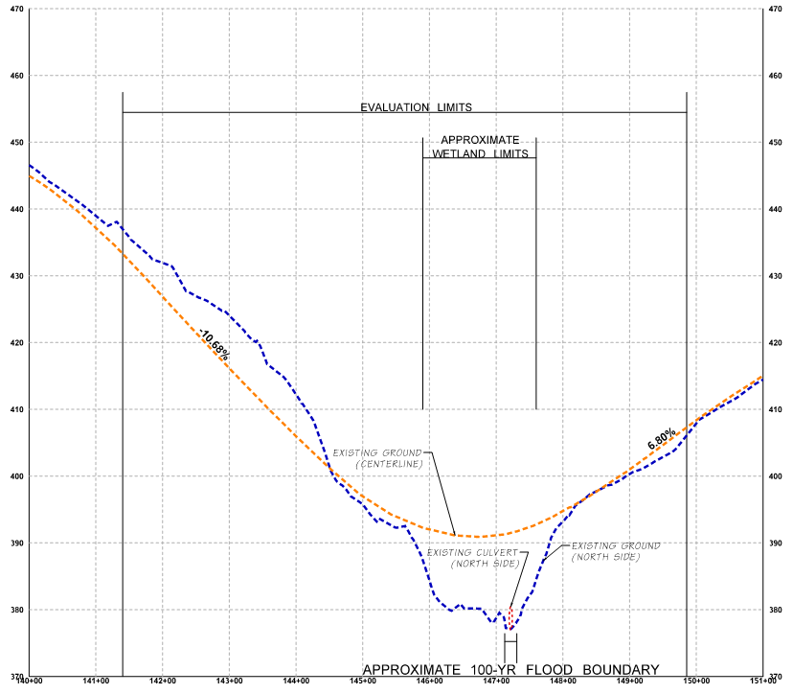
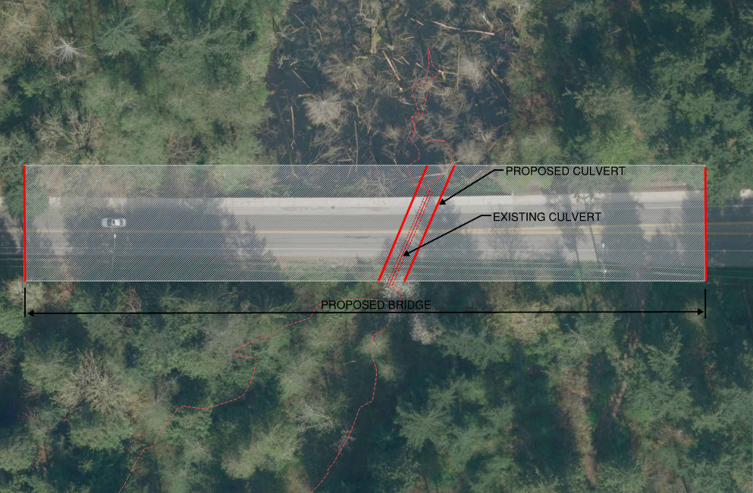
How Should We Cross N. Issaquah Creek?
5
Bridge or Culvert?
N
Notes:
KRISTINE
Welcome and introduce self and facilitator role
I first wanted to recognize any Council Members who have joined us this evening. If I can ask you to stand and wave, that would be great!
Also have quick introductions from the project team
From the City:
Sam Park, Project Manager
Steve Leniszewski, Director of Public Works
Cheryl Paston, Deputy Director of Public Works
Jim Grueber, Senior Project Engineer
Andrew Zagars, City Engineer
From HW Lochner, Consulting Engineer
Steve Lewis
Mark Burrus
Molly Toy
Rich Meredith
From EnviroIssues
(Kerri Franklin)
Kelly Foley – taking notes!

Slide 6
Things to Consider
6
Amount of Truck Traffic
Cost Difference
Full or Partial Road Closure
Maintenance Cost
Time of Construction
Notes:
KRISTINE
Welcome and introduce self and facilitator role
I first wanted to recognize any Council Members who have joined us this evening. If I can ask you to stand and wave, that would be great!
Also have quick introductions from the project team
From the City:
Sam Park, Project Manager
Steve Leniszewski, Director of Public Works
Cheryl Paston, Deputy Director of Public Works
Jim Grueber, Senior Project Engineer
Andrew Zagars, City Engineer
From HW Lochner, Consulting Engineer
Steve Lewis
Mark Burrus
Molly Toy
Rich Meredith
From EnviroIssues
(Kerri Franklin)
Kelly Foley – taking notes!

Slide 7
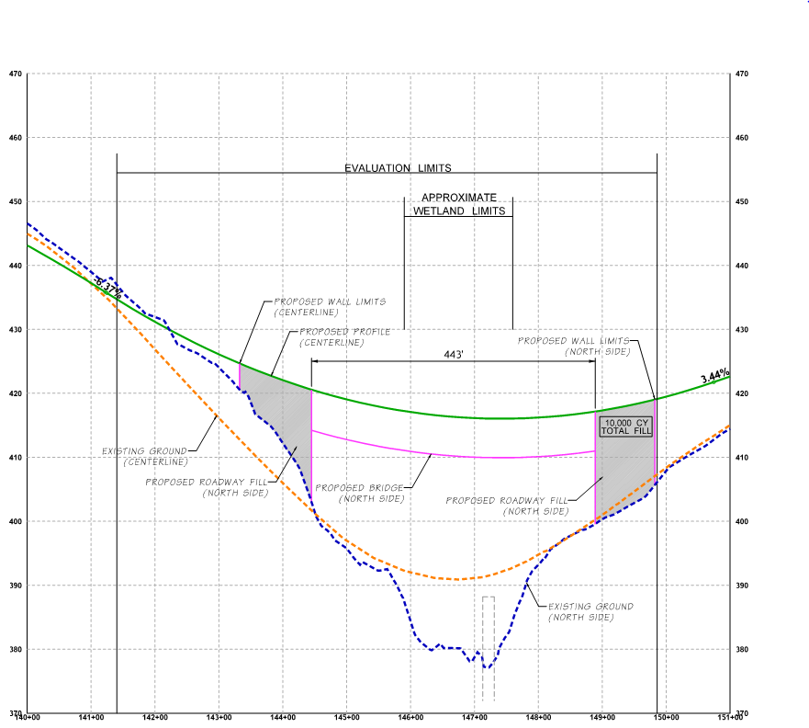
Option 1 - Bridge
7
1,000 Truck Loads
10,000 Cubic Yards of Fill
Notes:
KRISTINE
Welcome and introduce self and facilitator role
I first wanted to recognize any Council Members who have joined us this evening. If I can ask you to stand and wave, that would be great!
Also have quick introductions from the project team
From the City:
Sam Park, Project Manager
Steve Leniszewski, Director of Public Works
Cheryl Paston, Deputy Director of Public Works
Jim Grueber, Senior Project Engineer
Andrew Zagars, City Engineer
From HW Lochner, Consulting Engineer
Steve Lewis
Mark Burrus
Molly Toy
Rich Meredith
From EnviroIssues
(Kerri Franklin)
Kelly Foley – taking notes!

Slide 8
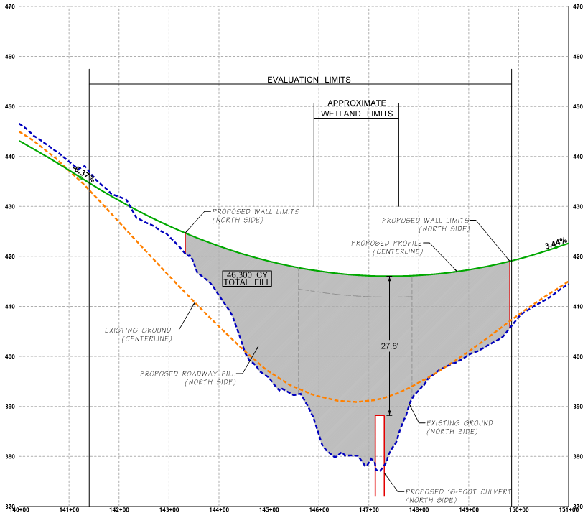
Option 2 - Culvert
8
6,000 Truck Loads
46,300 Cubic Yards of Fill
Notes:
KRISTINE
Welcome and introduce self and facilitator role
I first wanted to recognize any Council Members who have joined us this evening. If I can ask you to stand and wave, that would be great!
Also have quick introductions from the project team
From the City:
Sam Park, Project Manager
Steve Leniszewski, Director of Public Works
Cheryl Paston, Deputy Director of Public Works
Jim Grueber, Senior Project Engineer
Andrew Zagars, City Engineer
From HW Lochner, Consulting Engineer
Steve Lewis
Mark Burrus
Molly Toy
Rich Meredith
From EnviroIssues
(Kerri Franklin)
Kelly Foley – taking notes!

Slide 9
BRIDGE VS. CULVERT
9
Proposed Slope = ~6%
Notes:
KRISTINE
Welcome and introduce self and facilitator role
I first wanted to recognize any Council Members who have joined us this evening. If I can ask you to stand and wave, that would be great!
Also have quick introductions from the project team
From the City:
Sam Park, Project Manager
Steve Leniszewski, Director of Public Works
Cheryl Paston, Deputy Director of Public Works
Jim Grueber, Senior Project Engineer
Andrew Zagars, City Engineer
From HW Lochner, Consulting Engineer
Steve Lewis
Mark Burrus
Molly Toy
Rich Meredith
From EnviroIssues
(Kerri Franklin)
Kelly Foley – taking notes!

Slide 10

BRIDGE VS. CULVERT
10
Construction Cost = $6.20M
Mitigation Cost = $0.40M
20 Year Maintenance Cost = $0.08M
Additional Pavement Wear = $0.70M
Construction Traffic Control = $1.00M
Total Cost = $8.38M
Bridge Life Expectancy ≈ 75 - 100 years
Construction Length = 14 months
Two lanes open (with flaggers)
Environmental Impacts = Low
Tribal Support = Bridge Preferred
Fill ≈ 10,000 Cubic Yards
Truck Loads ≈ 1,000
Construction Cost = $3.67M
Mitigation Cost = $0.60M
20 Year Maintenance Cost = $0.25M
Additional Pavement Wear = $2.00M
Construction Traffic Control = $0.30M
Total Cost = $6.82M
Culvert Life Expectancy ≈ 70 - 100 years
Construction Length = 4 months
Full Road Closure
Environmental Impacts = Medium
Tribal Support = Bridge Preferred
Fill ≈ 46,300 Cubic Yards
Truck Loads ≈ 6,000
= 500 trucks
(15 TON loads)
Notes:
KRISTINE
Welcome and introduce self and facilitator role
I first wanted to recognize any Council Members who have joined us this evening. If I can ask you to stand and wave, that would be great!
Also have quick introductions from the project team
From the City:
Sam Park, Project Manager
Steve Leniszewski, Director of Public Works
Cheryl Paston, Deputy Director of Public Works
Jim Grueber, Senior Project Engineer
Andrew Zagars, City Engineer
From HW Lochner, Consulting Engineer
Steve Lewis
Mark Burrus
Molly Toy
Rich Meredith
From EnviroIssues
(Kerri Franklin)
Kelly Foley – taking notes!

Slide 11
BRIDGE VS. CULVERT
11
Total Cost = $8.38M
Construction Length = 14 months
Two lanes open (with flaggers)
Truck Loads ≈ 1,000
Total Cost = $6.82M
Construction Length = 4 months
Full Road Closure
Truck Loads ≈ 6,000
SELECTION:
Notes:
KRISTINE
Welcome and introduce self and facilitator role
I first wanted to recognize any Council Members who have joined us this evening. If I can ask you to stand and wave, that would be great!
Also have quick introductions from the project team
From the City:
Sam Park, Project Manager
Steve Leniszewski, Director of Public Works
Cheryl Paston, Deputy Director of Public Works
Jim Grueber, Senior Project Engineer
Andrew Zagars, City Engineer
From HW Lochner, Consulting Engineer
Steve Lewis
Mark Burrus
Molly Toy
Rich Meredith
From EnviroIssues
(Kerri Franklin)
Kelly Foley – taking notes!

Slide 12
Keep in Mind:
12
Total project duration 24 months
Bridge / Culvert decision does not affect total duration
Notes:
KRISTINE
Welcome and introduce self and facilitator role
I first wanted to recognize any Council Members who have joined us this evening. If I can ask you to stand and wave, that would be great!
Also have quick introductions from the project team
From the City:
Sam Park, Project Manager
Steve Leniszewski, Director of Public Works
Cheryl Paston, Deputy Director of Public Works
Jim Grueber, Senior Project Engineer
Andrew Zagars, City Engineer
From HW Lochner, Consulting Engineer
Steve Lewis
Mark Burrus
Molly Toy
Rich Meredith
From EnviroIssues
(Kerri Franklin)
Kelly Foley – taking notes!

Slide 13
Next Steps
13
Public Meeting #3 March/April 2017
30% Design Completion April 2017
Public Meeting (Detour Planning) June 2017
60% Design Completion September 2017
Project Bid Feb/March 2018
Project Construction Begins June 2018
Notes:
KRISTINE
Welcome and introduce self and facilitator role
I first wanted to recognize any Council Members who have joined us this evening. If I can ask you to stand and wave, that would be great!
Also have quick introductions from the project team
From the City:
Sam Park, Project Manager
Steve Leniszewski, Director of Public Works
Cheryl Paston, Deputy Director of Public Works
Jim Grueber, Senior Project Engineer
Andrew Zagars, City Engineer
From HW Lochner, Consulting Engineer
Steve Lewis
Mark Burrus
Molly Toy
Rich Meredith
From EnviroIssues
(Kerri Franklin)
Kelly Foley – taking notes!

Slide 14

Questions?
14
Notes:
KRISTINE
Welcome and introduce self and facilitator role
I first wanted to recognize any Council Members who have joined us this evening. If I can ask you to stand and wave, that would be great!
Also have quick introductions from the project team
From the City:
Sam Park, Project Manager
Steve Leniszewski, Director of Public Works
Cheryl Paston, Deputy Director of Public Works
Jim Grueber, Senior Project Engineer
Andrew Zagars, City Engineer
From HW Lochner, Consulting Engineer
Steve Lewis
Mark Burrus
Molly Toy
Rich Meredith
From EnviroIssues
(Kerri Franklin)
Kelly Foley – taking notes!

Slide 16
Full Design Layout

Slide 17
Decision Matrix

