Slide 1
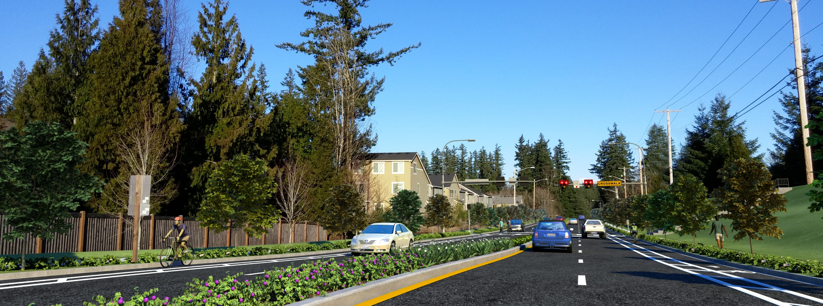


Issaquah-Fall City Road
Project Update
City Council Study Session
March 13, 2018

Slide 2
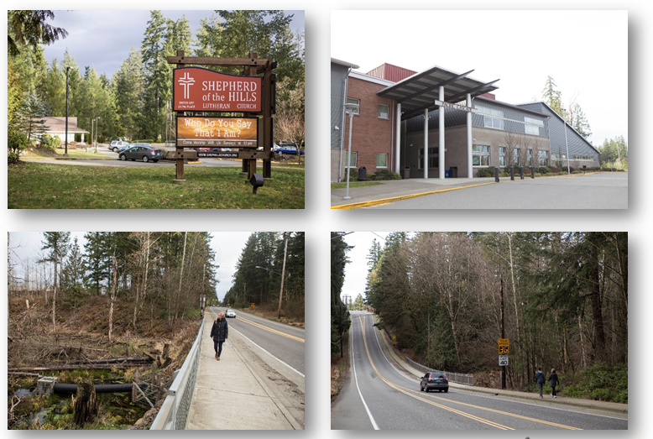
Meeting Agenda
Introductions
Schedule
Cost Implications
Factors Driving Cost
Actions Taken
Potential Cost Savings
Discussion
Direction from Council

Slide 3
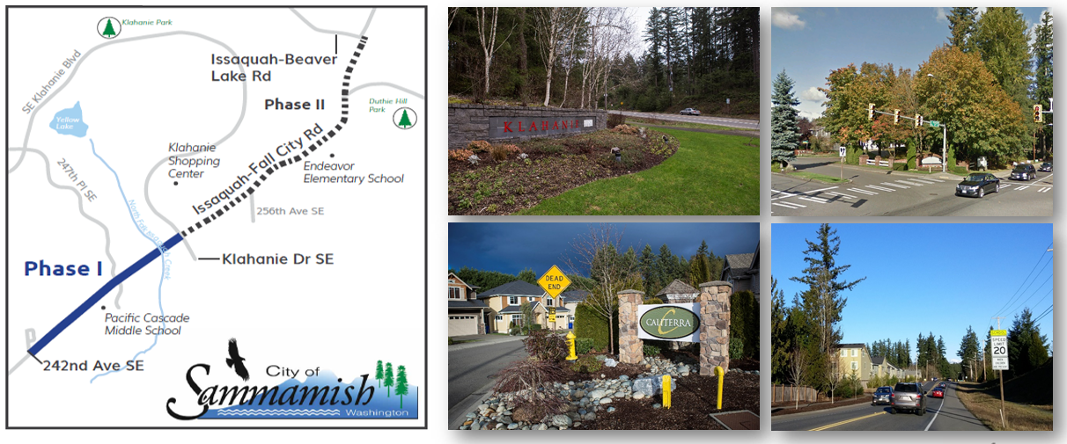
Project Overview – Congestion Relief & Safety

Slide 4
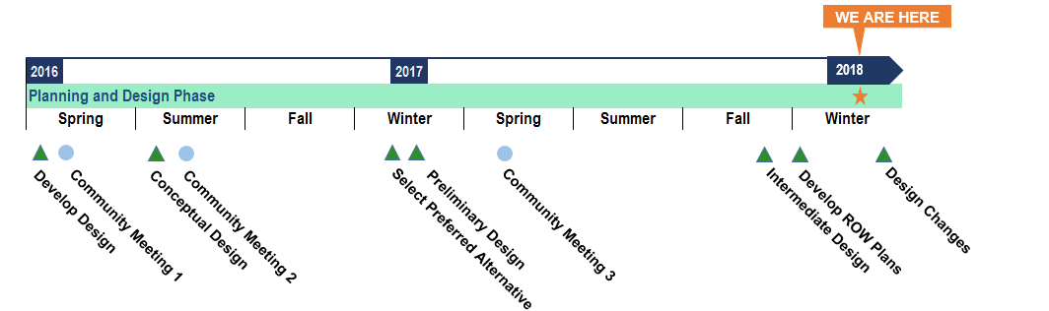
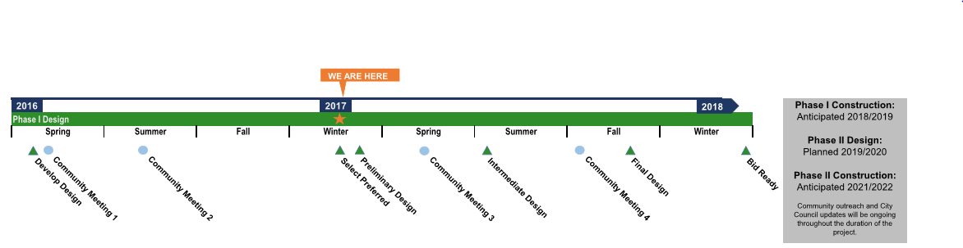
Project Timeline

Slide 5
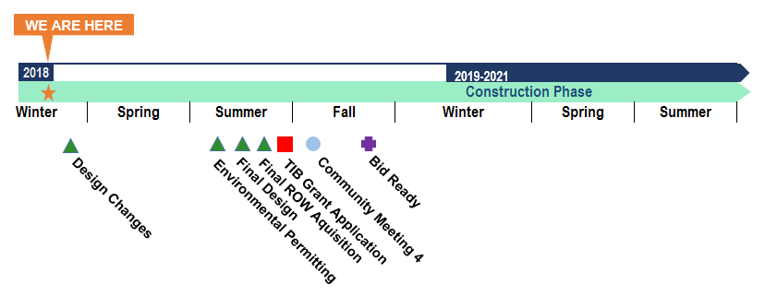
Project Timeline

Slide 6
Preliminary Estimates of Probable Construction $
Estimates include Construction Activities only
Conceptual Design Estimate (Nov., 2014) | $16.2 Million
Planning Level Estimate (Feb., 2017) | $20.3 Million
Preliminary Design Estimate (June, 2017) | $23.1 Million
Intermediate Design Estimate | $27.8 Million

Slide 7
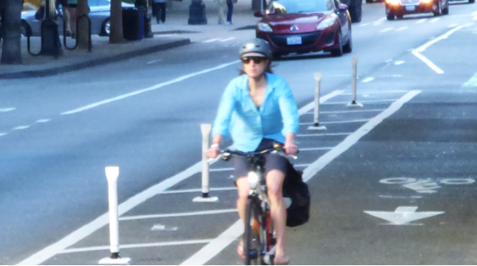
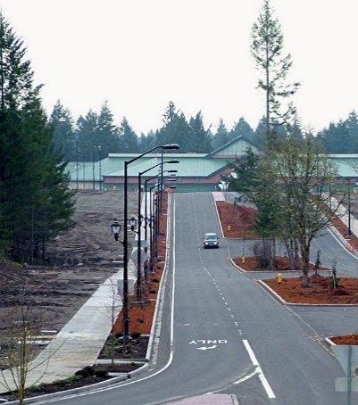
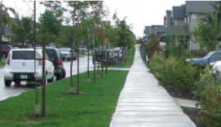
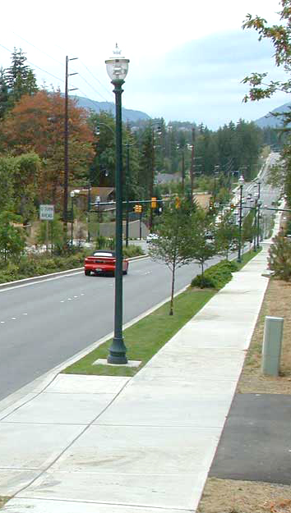
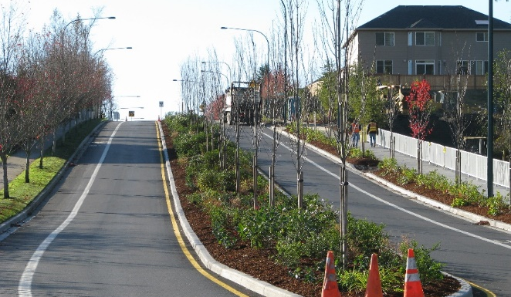
What Changed – Conceptual to Preliminary?
Changed Intersection Types to Roundabouts
Selected Bridge to Replace Culvert
Selected Landscaped Medians, Irrigation, and Bike Lane Buffers

Slide 8
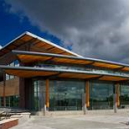
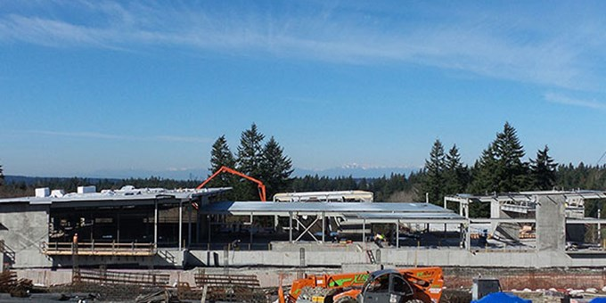
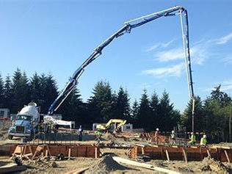
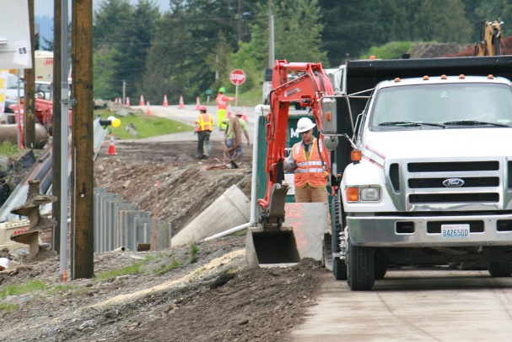
What Changed – Preliminary to Intermediate Design?
Increased Median Width – Adding Walls
Changed Drainage Design to Relocate Proposed Pond
Geotech Report – Poor Soils Impacts Bridge Foundations
Prosperity – Good Economy Increasing Unit Prices (FHWA Cost Indices) 7.8% Summer 2017

Slide 9

What Have We Been Doing to Address Escalation?
Identified Major Cost Drivers
Conducted “Mini” Value Engineering Workshop in Lochner
Engaged Regional Contractor to Review Approach & Identify Potential Savings

Slide 10
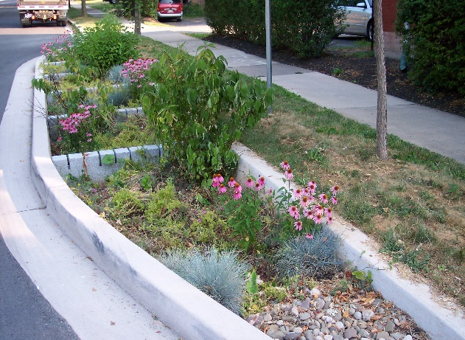
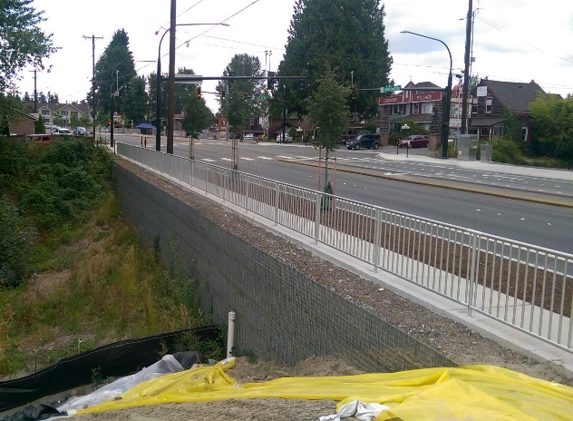
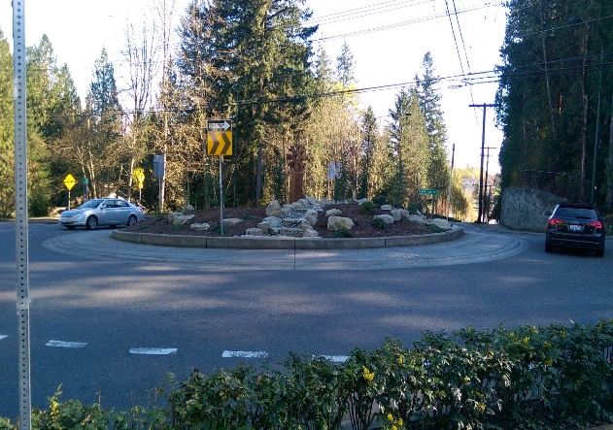
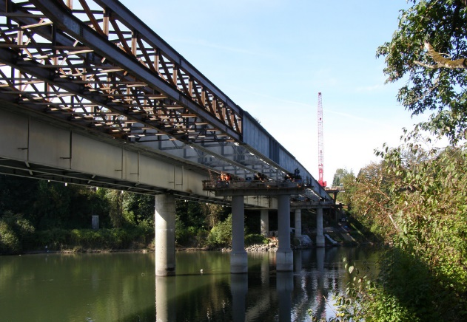
Potential Cost Savings
Focused on Major Cost Drivers
  Bridge Design & Construction Methods
  Reduced Roadway Cross Section
  Walls – Number & Type
  Intersections – Design Modifications

Slide 11
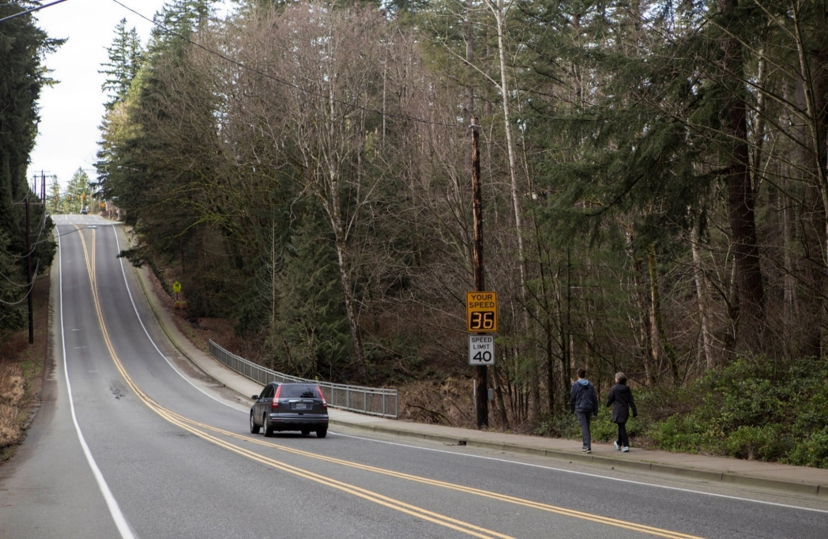
Current Plan – Stay the Course
Cost | $26.2 Million
Schedule | 15 to 18 months For Bridge Construction
Issues | 1. Construction Estimate Over Budget 2. Keeps Roadway Open During Construction 3. Construction Estimate includes Potential Cost Savings from Redesign 4. Some Traffic Will Avoid Construction

Slide 12
Preliminary Estimates of Probable Construction $
Estimates include Construction Activities only
Conceptual Design Estimate (Nov., 2014) | $16.2 Million
Planning Level Estimate (Feb., 2017) | $20.3 Million
Preliminary Design Estimate (June, 2017) | $23.1 Million
Intermediate Design Estimate | $27.8 Million
Current Plan – Stay the Course | $26.2 Million

Slide 13
Alternative – Close the Road
Cost | $22.3 Million
Schedule | 6 to 7 months closure For bridge construction
Issues | 1. Reduced Construction Cost 2. Shorter Bridge Construction Schedule 3. Reduces Number of Impacted Trees 4. All Traffic Must Detour

Slide 14
Preliminary Estimates of Probable Construction $
Estimates include Construction Activities only
Conceptual Design Estimate (Nov., 2014) | $16.2 Million
Planning Level Estimate (Feb., 2017) | $20.3 Million
Preliminary Design Estimate (June, 2017) | $23.1 Million
Intermediate Design Estimate | $27.8 Million
Current Plan – Stay the Course | $26.2 Million
Alternative – Close the Road | $22.3 Million

Slide 15
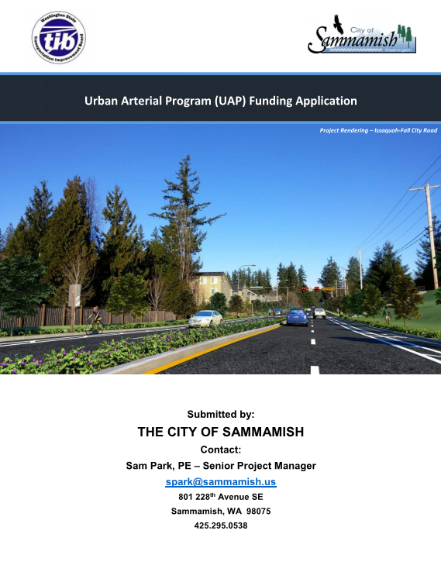
Funding
Transportation Improvement Board
  2017 Application
    $5M Request
    Missed by One Point
    “Shovel Readiness”
  2018 Potential Application
    Due, August of 2018
    Award, November of 2018
    Funds Available, January of 2019

Slide 16
Next Steps
Looking For Council Direction to:
  Stay the Course with Roadway Design Modifications, or
  Approval to Close the Roadway for Bridge Construction

Slide 17

Discussion

