Slide 1

SAMMAMISH POLICE
Public Safety Presentation
October 10th, 2023
Connecting with Community

Slide 2

Community Engagement Officer
2nd Quarter Stats for Detective Nate Greiert…
Meeting Type | Quarterly Total
Community Meeting/HOA | 3
Meetings with individual community members | 5
Email Contacts | 92 (emails received and responses)
Community Precinct Tours | 2
Boy Scout/Girl Scout Presentations | 3
Community Training Events | 11
Police explorers
Bi weekly police explorer meetings, planning for and attendance at events, 6 meetings
-explorer academy
-4th on the plateau
sammamish.us/government/police/community-engagement-officer/

Slide 3
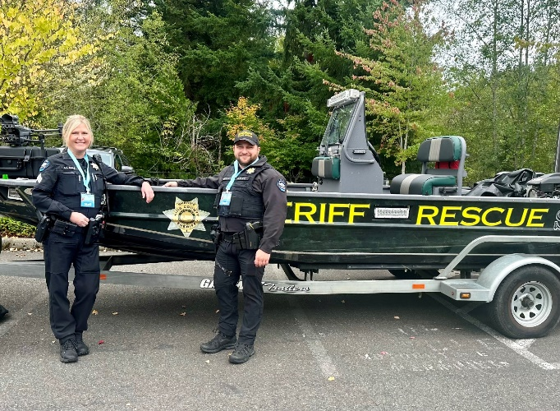
Ongoing Engagement
In progress
Sammamish Community Member Academy Sept – Nov.
Safety/winter conditions community resource fair – co-planning with Eastside Fire.
PGA tour June 2024.
CRASE training for school districts and businesses.
Active shooter training for Sammamish PD.
Outreach to private preschools within the city to provide training and emergency planning.
Home security booklet for Sammamish community members.
Stop the bleed training for city staff.

Slide 4
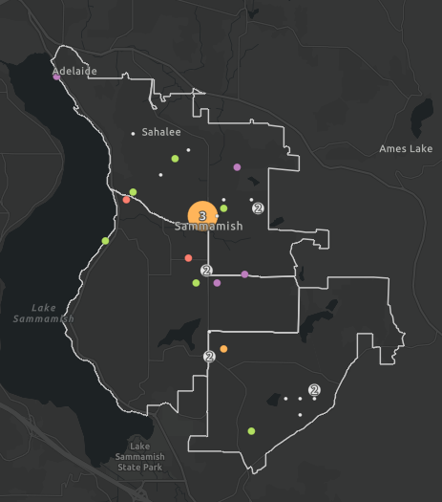
Data Dashboard
Dashboard is live on web
Real-time crime data updates
Dedicated Engagement Officer page with outreach statistics
https://www.sammamish.us/government/police/crime-data/

Slide 5
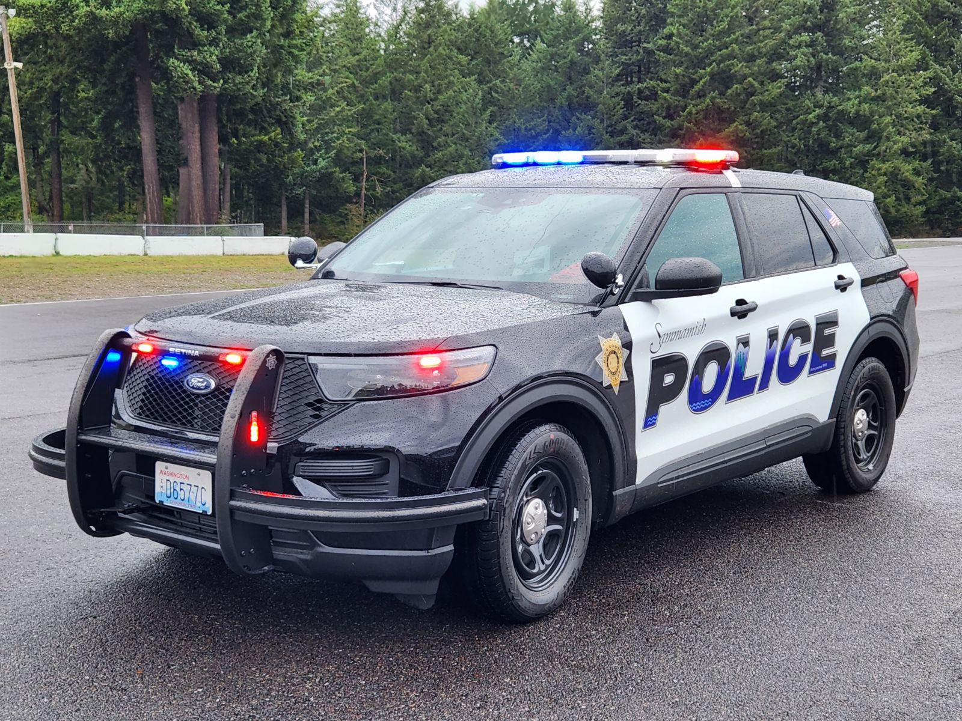
Hybrid Police Vehicles
First in the Sammamish fleet (in service 10/2)
Consistent with Sammamish Climate Action Plan
Reduced maintenance and operations cost
Reduced fuel consumption
Reduced emissions and associated environmental damage
Replaced through normal attrition

Slide 6
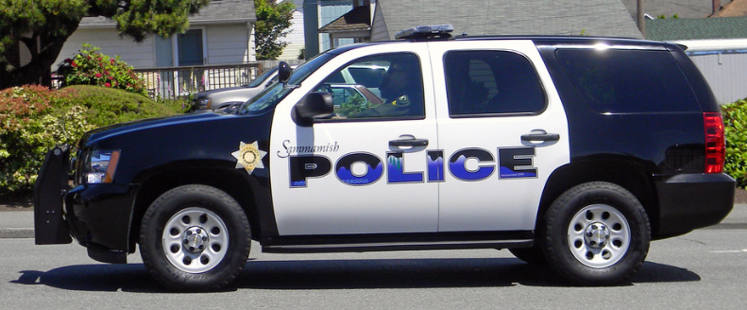
Current Vehicle Graphics
Design for almost 15 years…

Slide 7
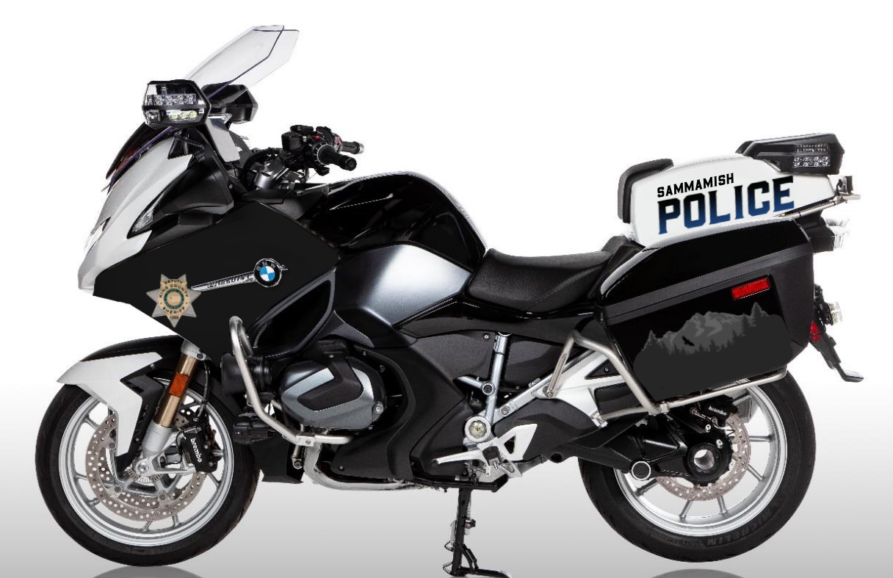


Updated Motorcycle Graphics

Slide 8
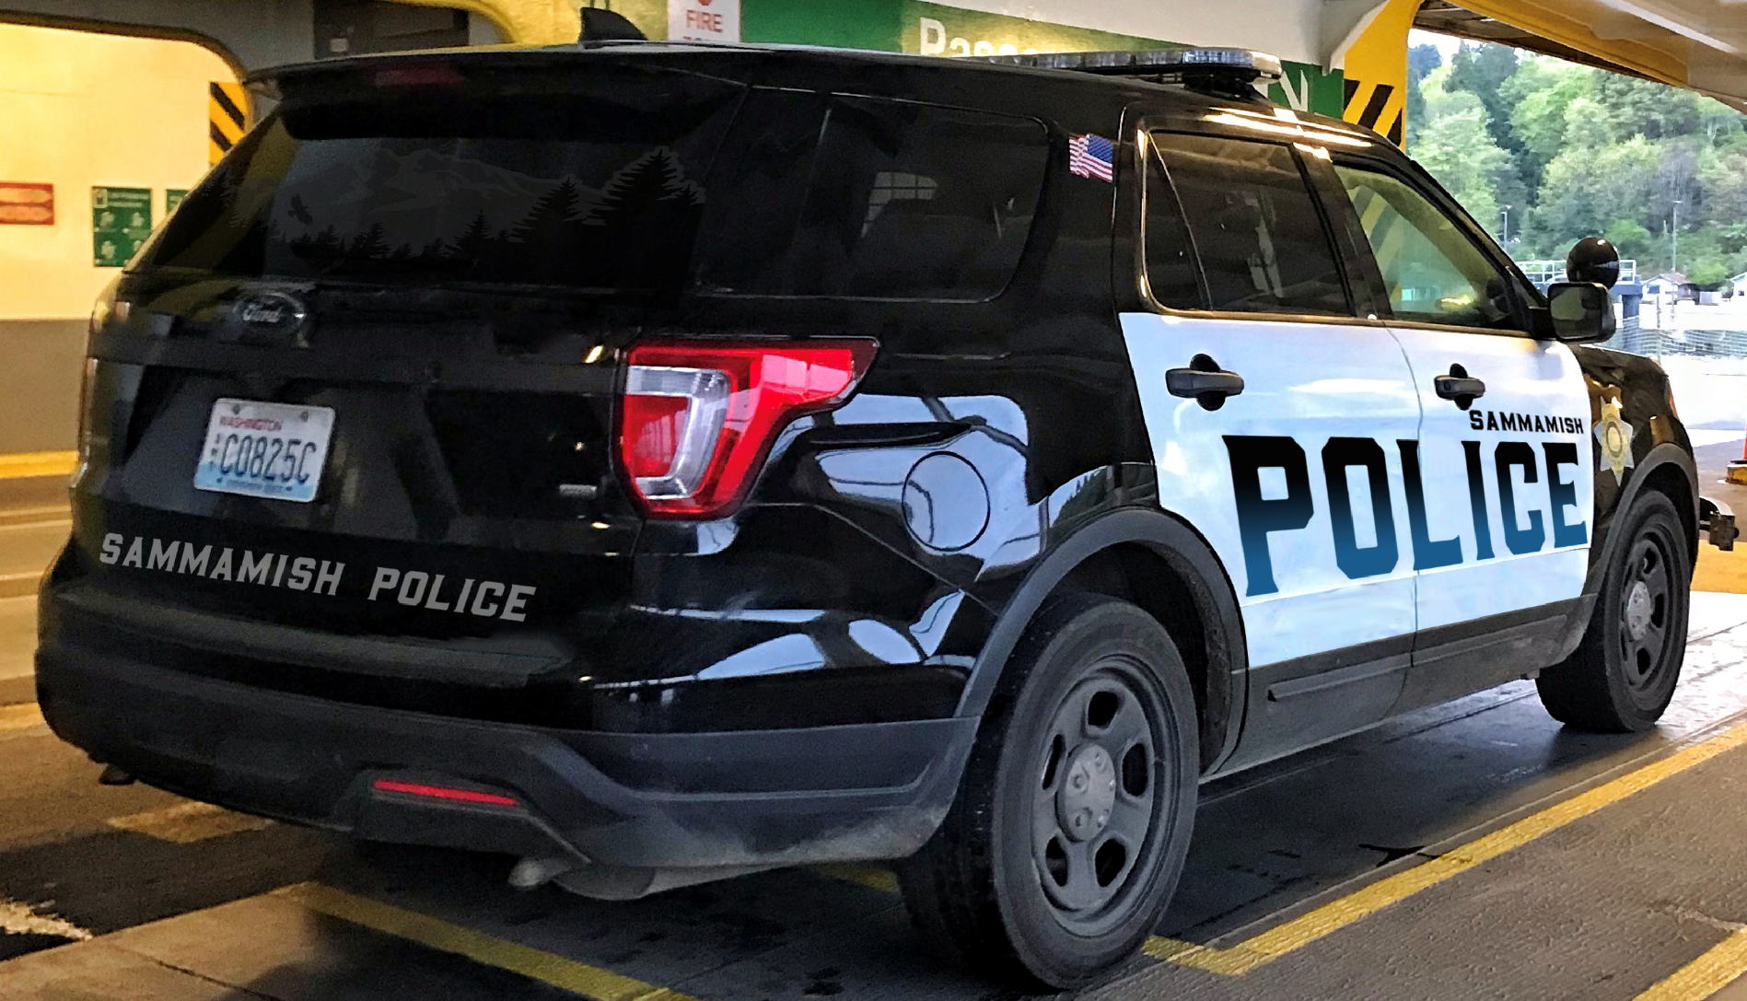
Updated Vehicle Graphics

Slide 9
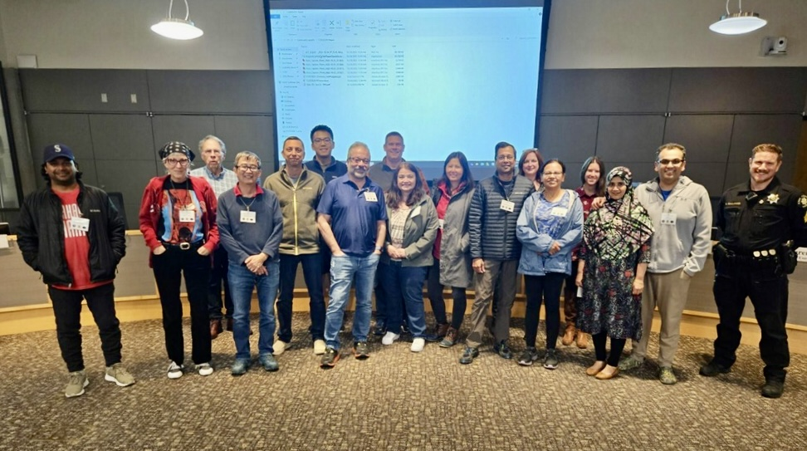
1st Community Academy
In partnership with Woodinville PD and KCSO
10-week course
28 attendees - 18 Sammamish

Slide 10
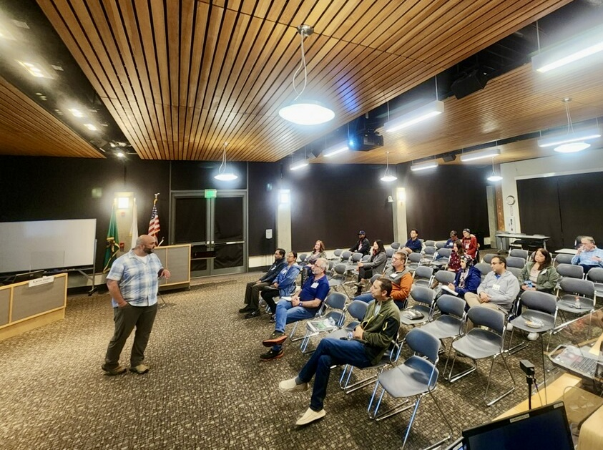
1st Community Academy
Blocks of instruction include:
MCU (Green River) & SAU
MARR, DUI, K-9, Marine Unit
Patrol Ops, SAR, EVOC
Comm Center, SWAT, Traffic
AFIS, Drones
Constitutional Use of Force

Slide 11
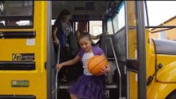
Public Safety Resources
Traffic Tip Tuesdays!
https://www.sammamish.us/government/police/safety-tips/

Slide 12
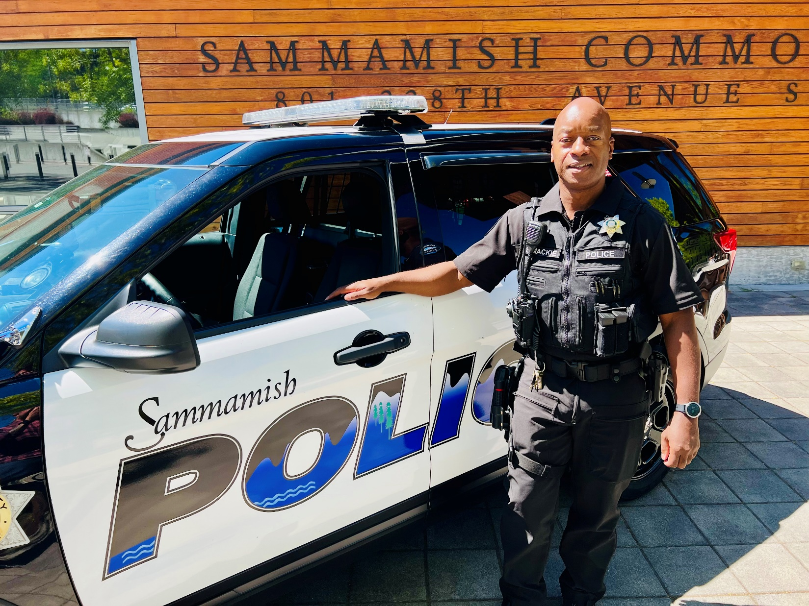
New Officer Onboarding Program

Slide 13
Social Media
Facebook Page
Jul 08 - Oct 05, 23
Sammamish Police Department
Post reactions & likes
744
likes
6.63%
engagement rate
The number of reactions to your posts on your Facebook and LinkedIn Pages and the number of likes your posts received on Instagram, Twitter, and TikTok. Customize the tile to compare the results for each social network

Slide 14
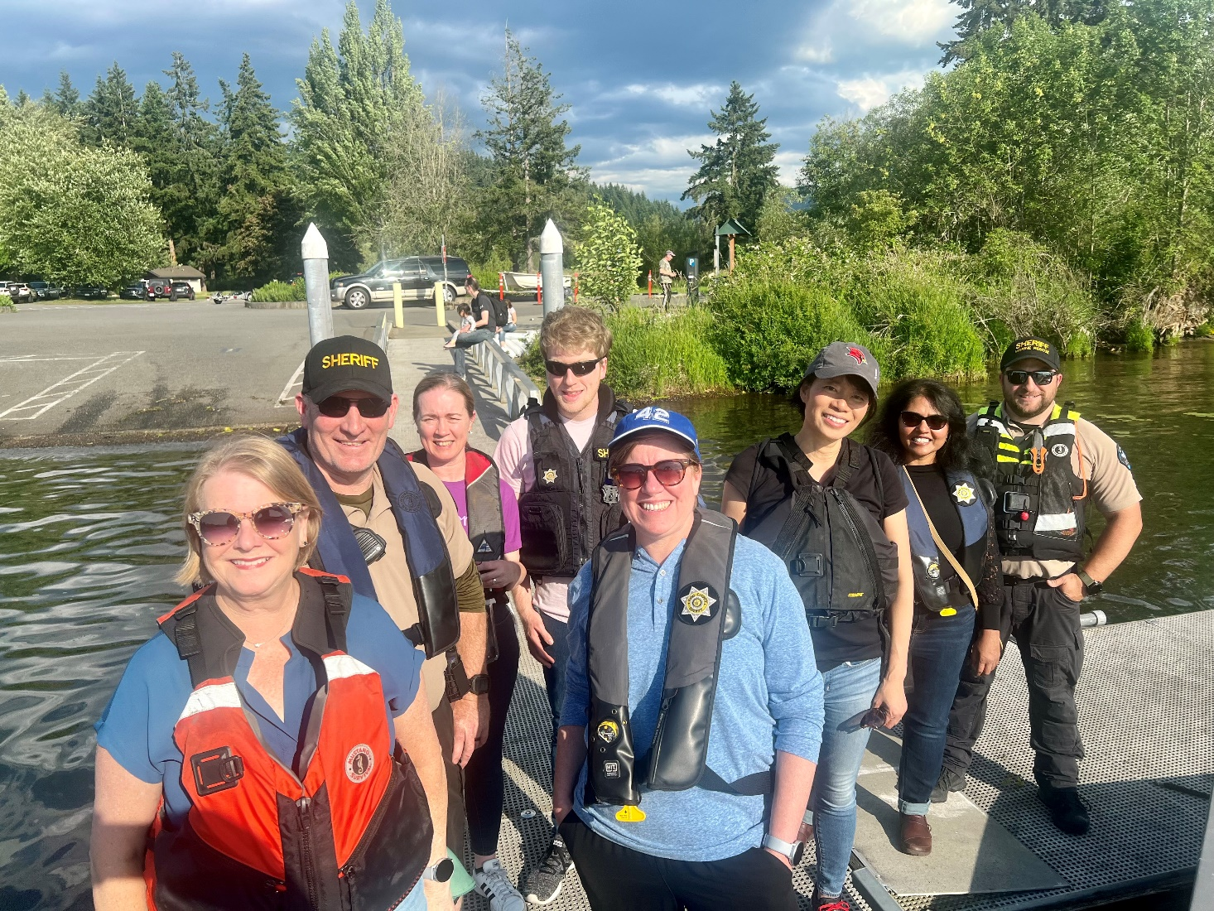

QUESTIONS?

